Slide 1
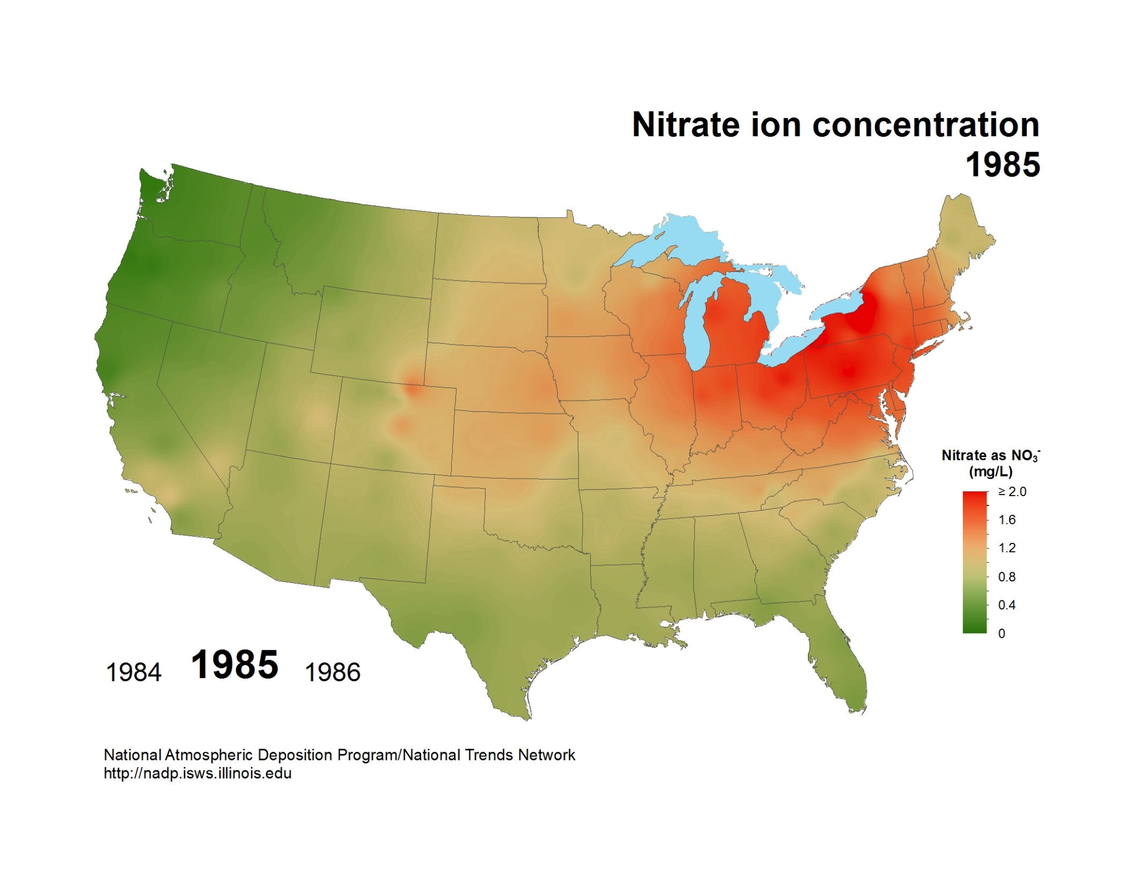
National Atmospheric Deposition Program/National Trends Network
http://nadp.slh.wisc.edu

Slide 2

National Atmospheric Deposition Program/National Trends Network
http://nadp.slh.wisc.edu

Slide 3
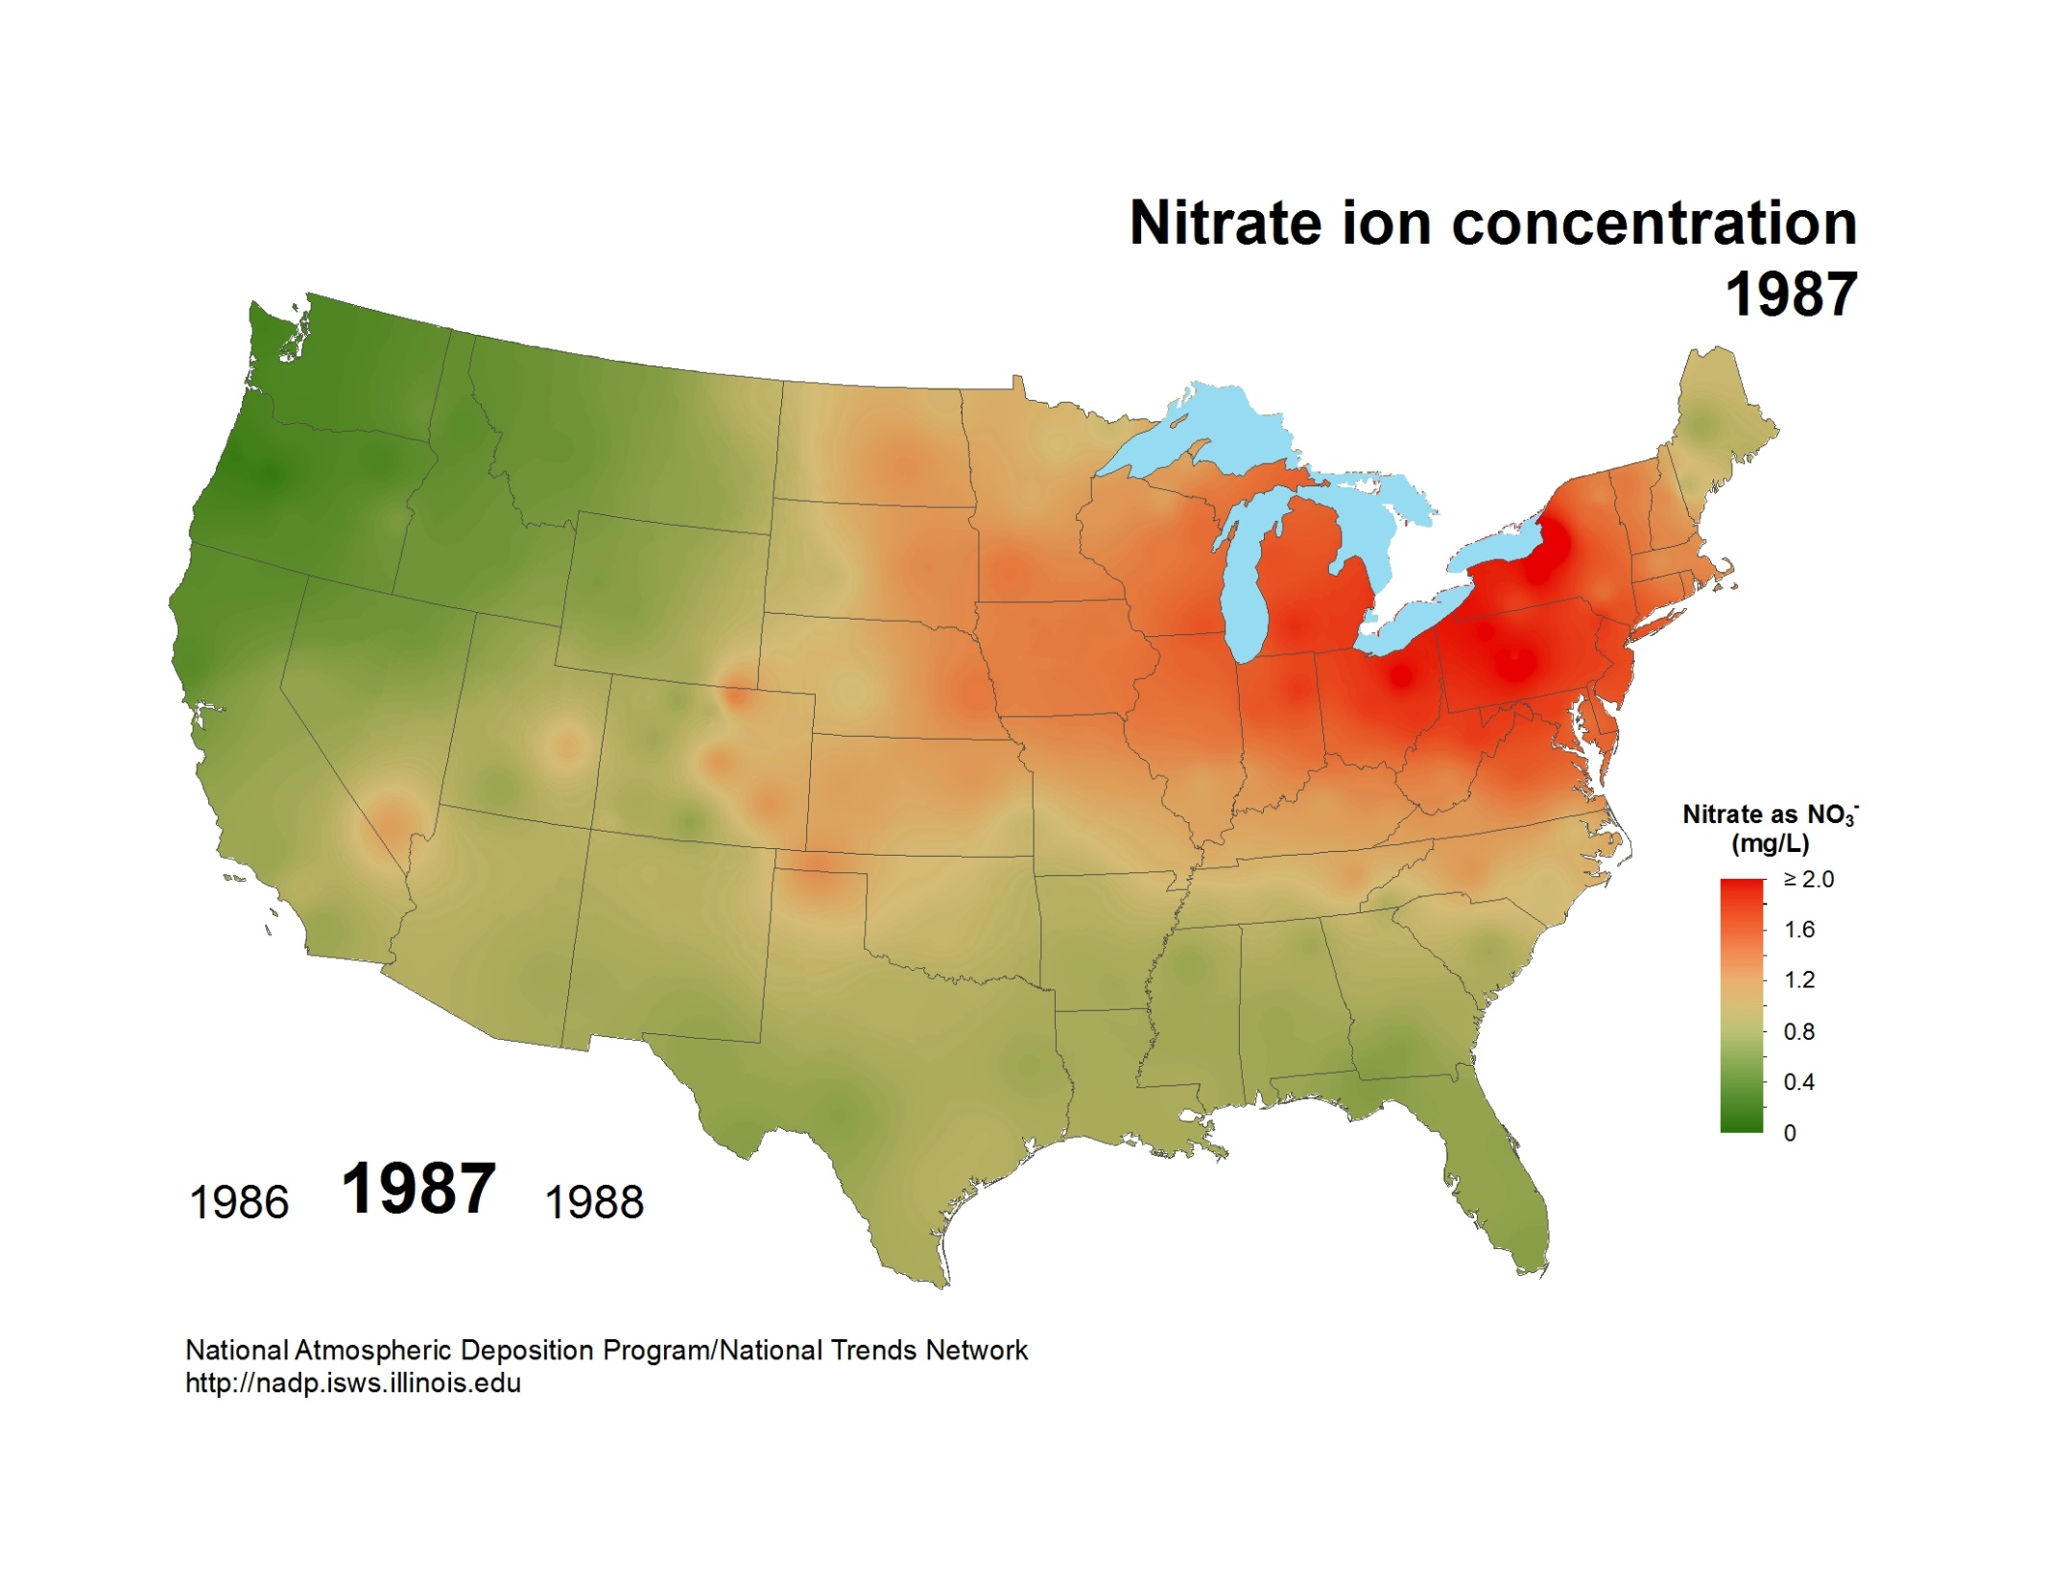
National Atmospheric Deposition Program/National Trends Network
http://nadp.slh.wisc.edu

Slide 4
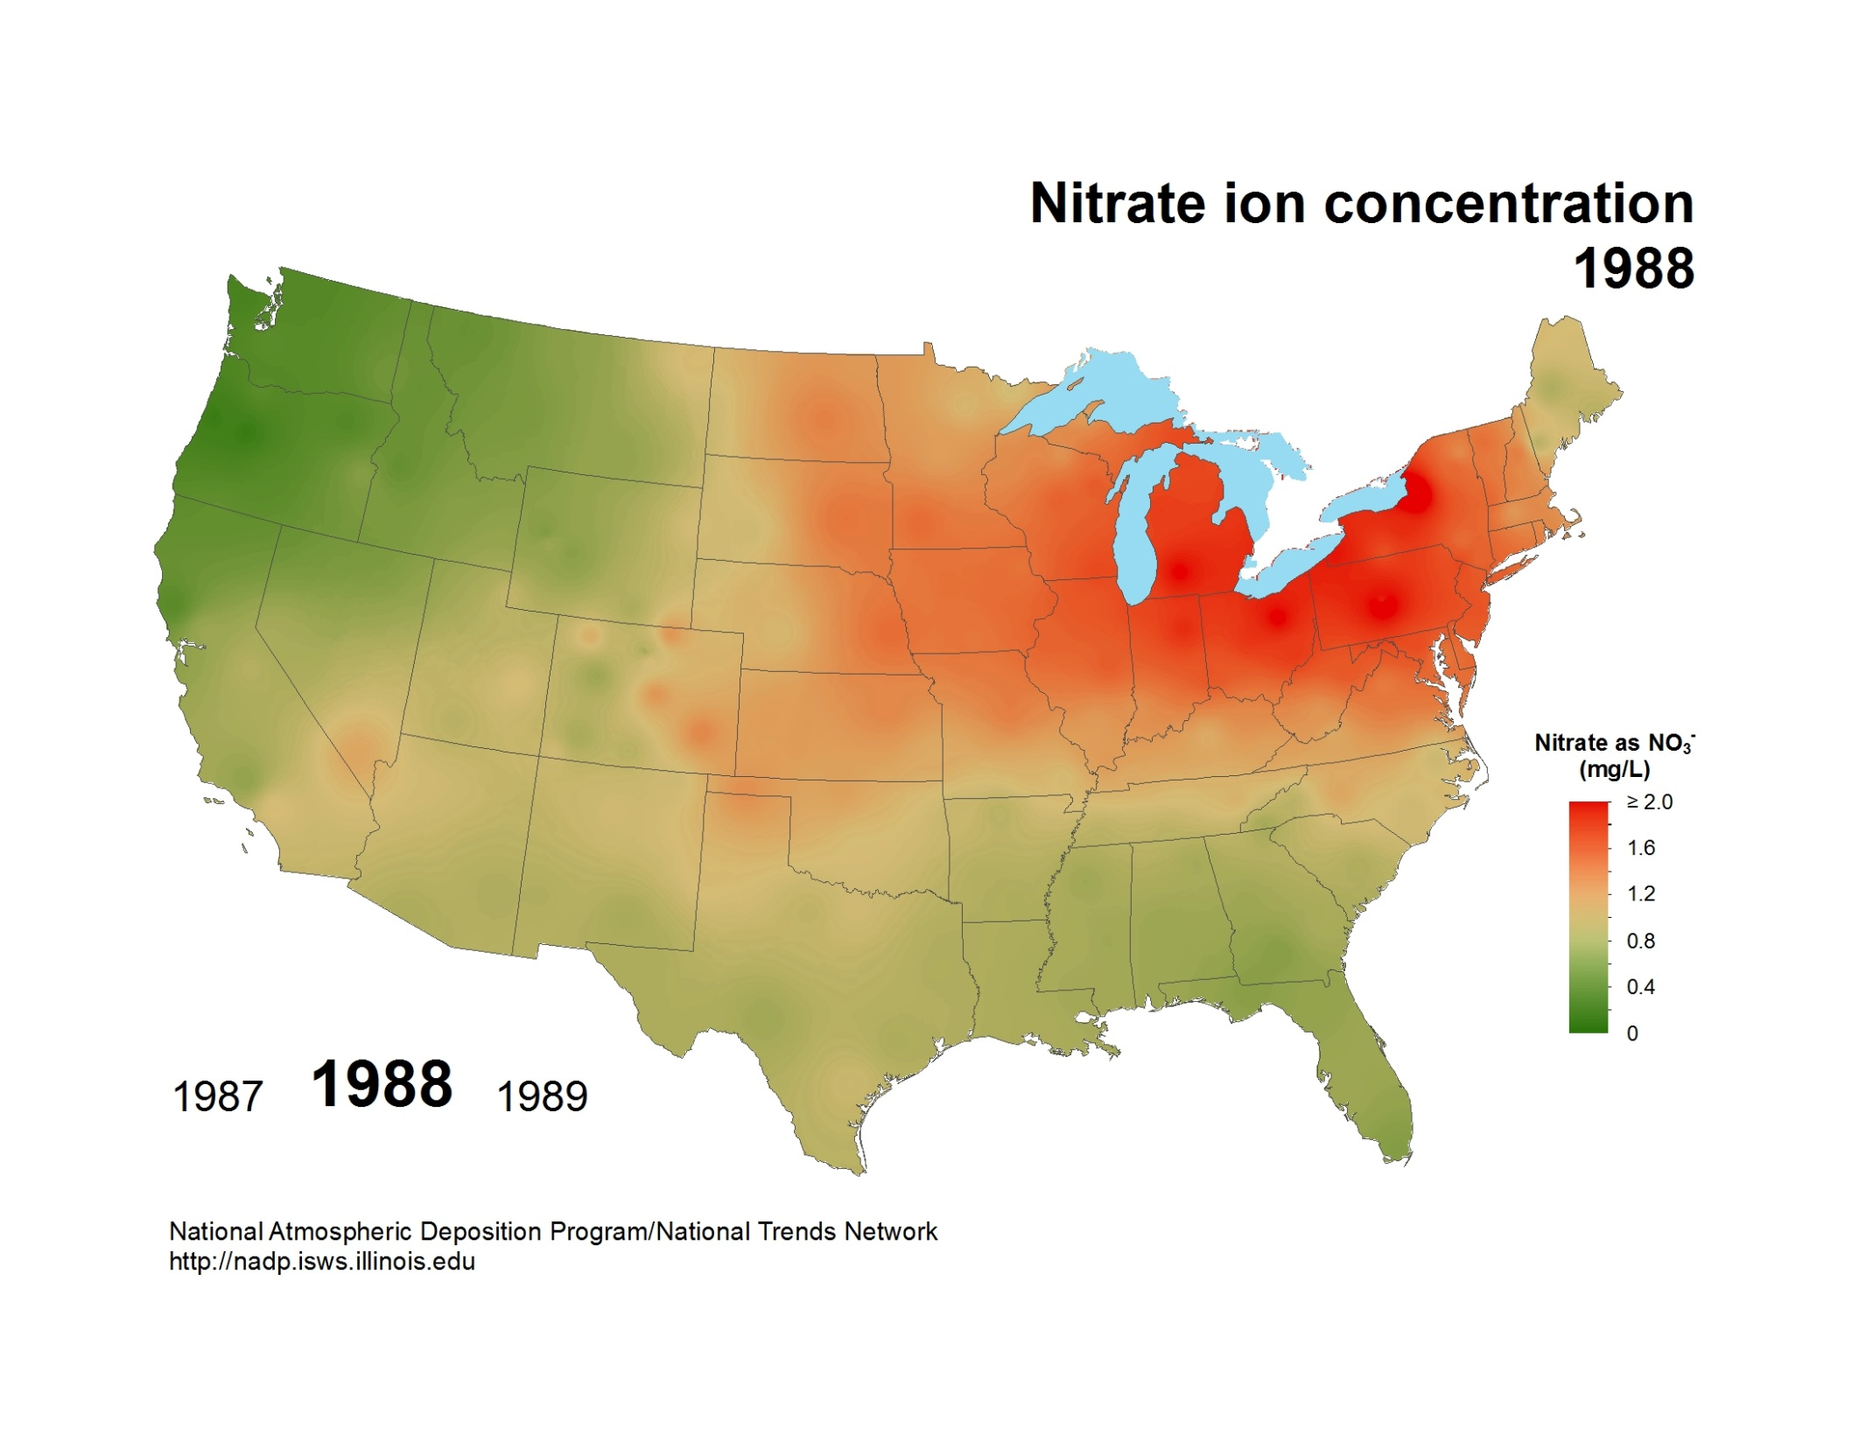
National Atmospheric Deposition Program/National Trends Network
http://nadp.slh.wisc.edu

Slide 5
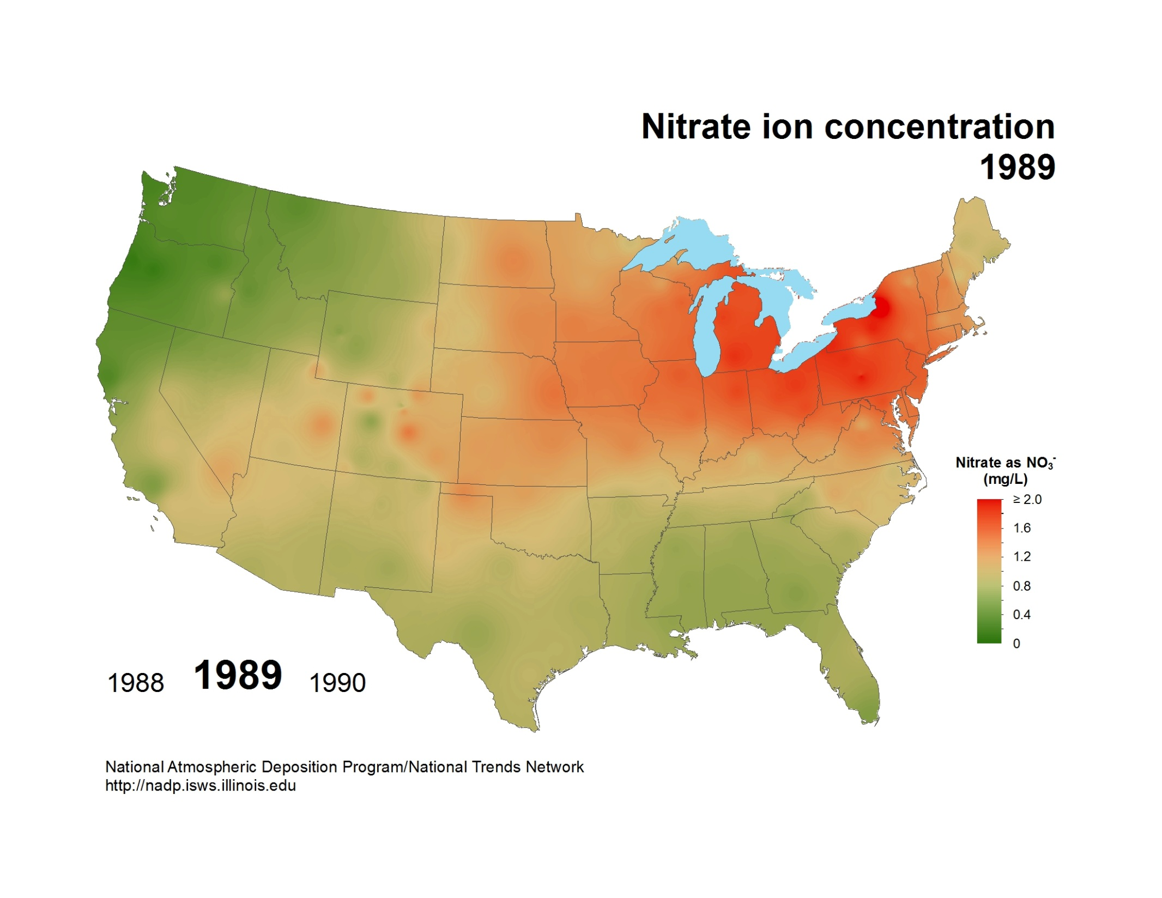
National Atmospheric Deposition Program/National Trends Network
http://nadp.slh.wisc.edu

Slide 6

National Atmospheric Deposition Program/National Trends Network
http://nadp.slh.wisc.edu

Slide 7
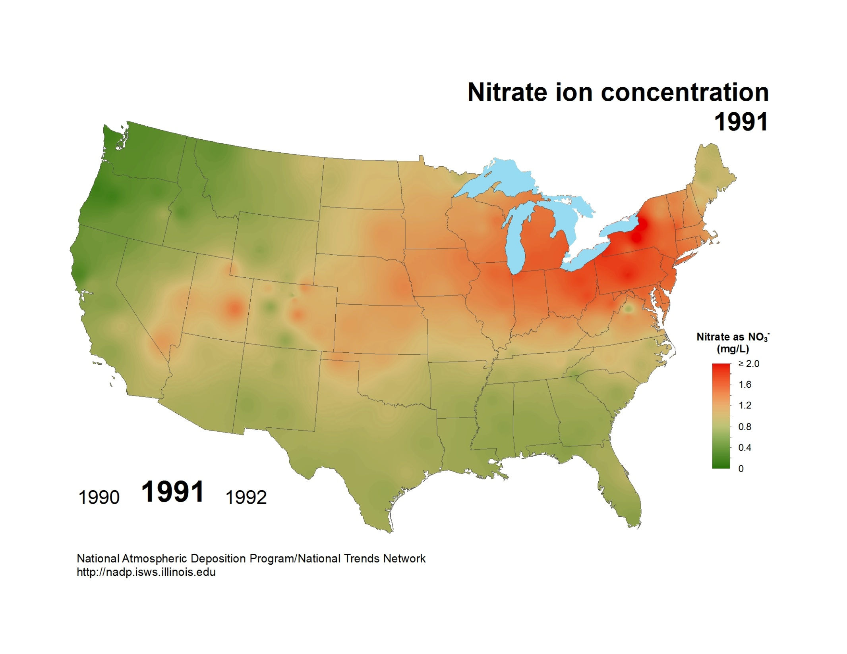
National Atmospheric Deposition Program/National Trends Network
http://nadp.slh.wisc.edu

Slide 8
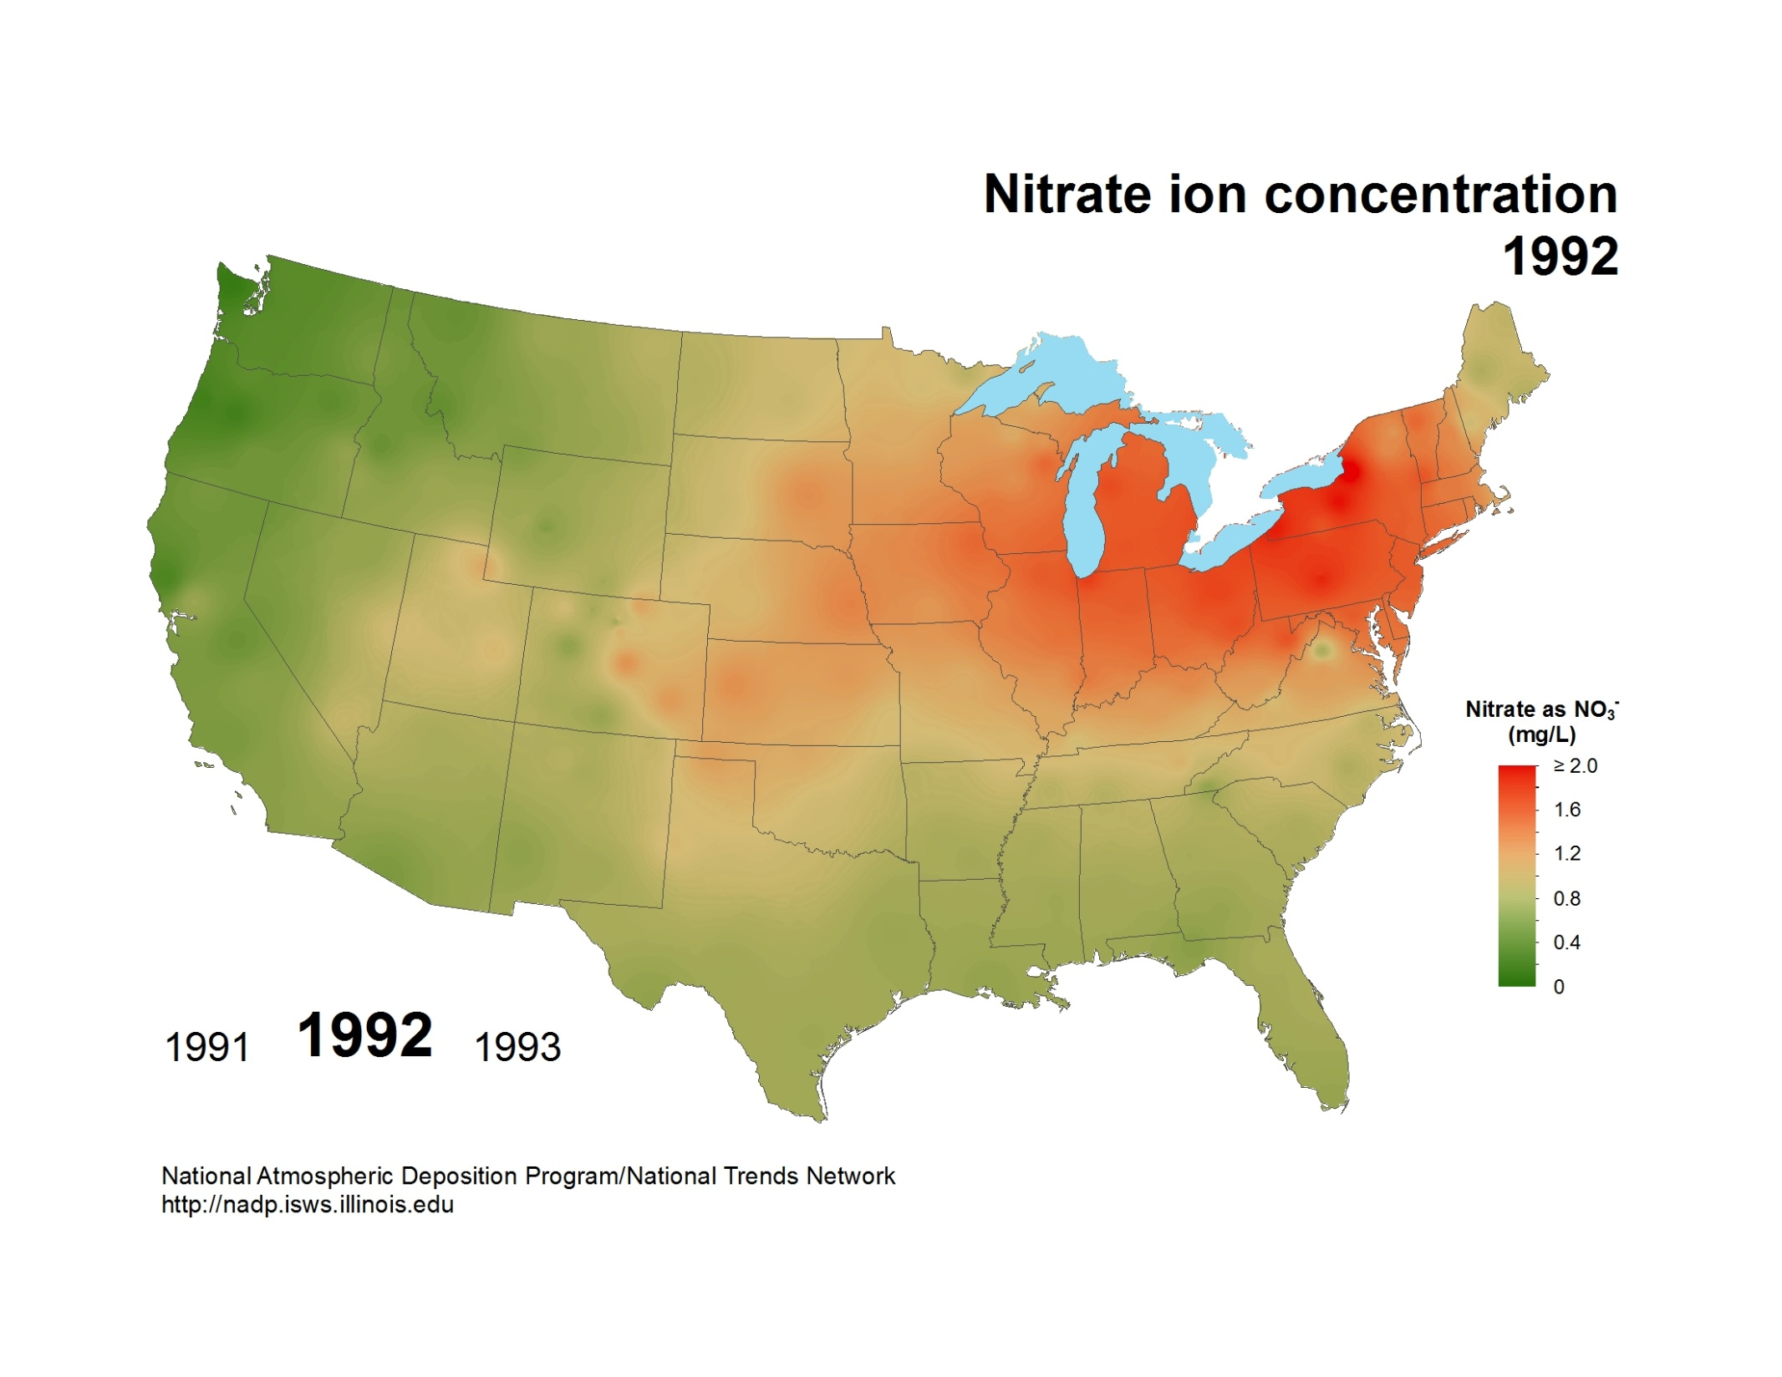
National Atmospheric Deposition Program/National Trends Network
http://nadp.slh.wisc.edu

Slide 9
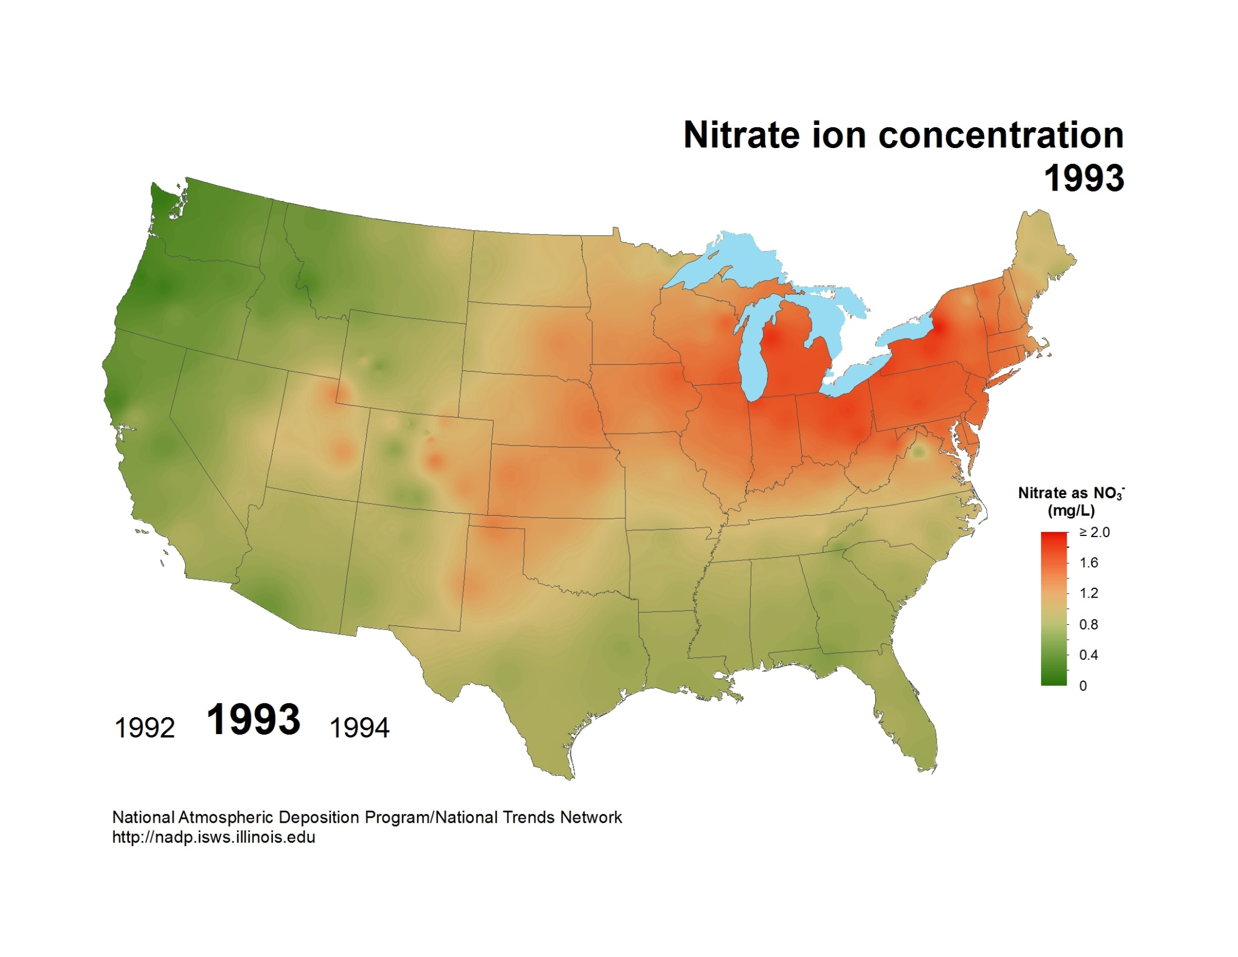
National Atmospheric Deposition Program/National Trends Network
http://nadp.slh.wisc.edu

Slide 10
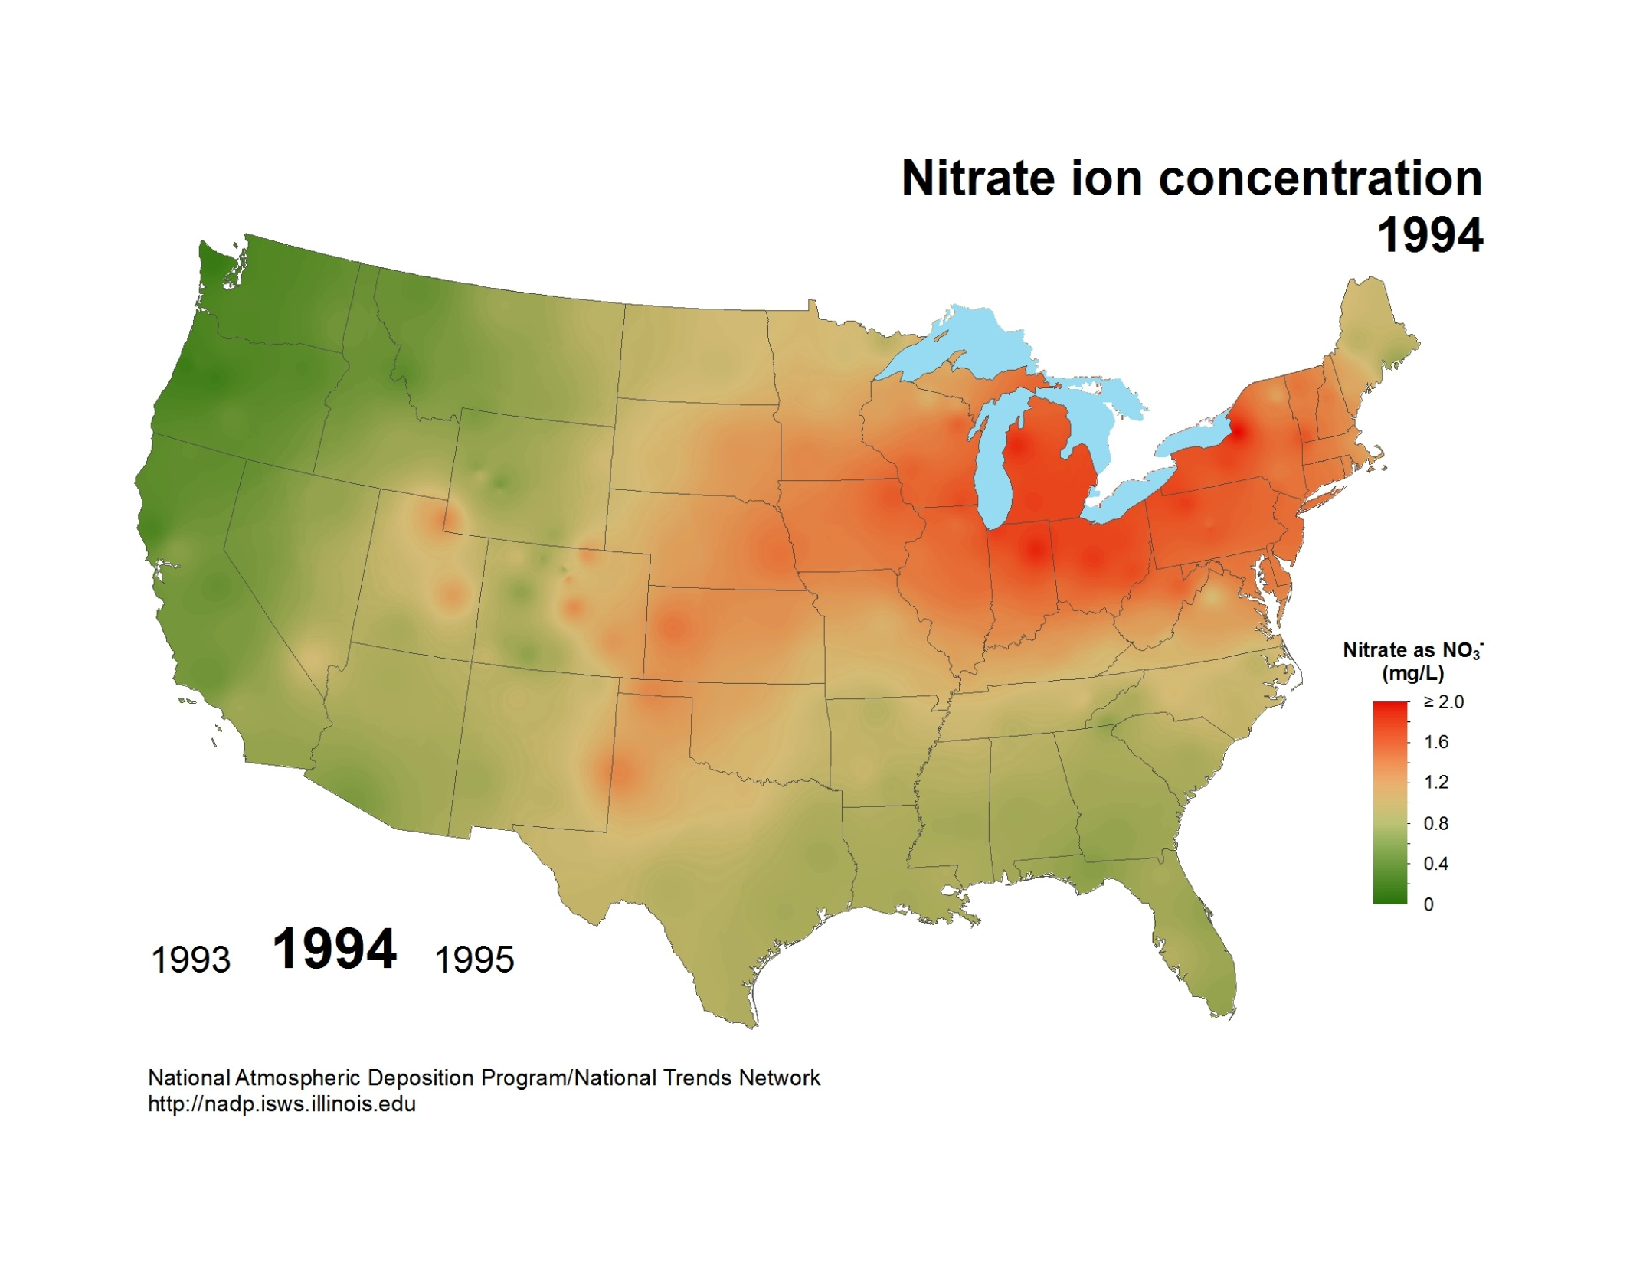
National Atmospheric Deposition Program/National Trends Network
http://nadp.slh.wisc.edu

Slide 11
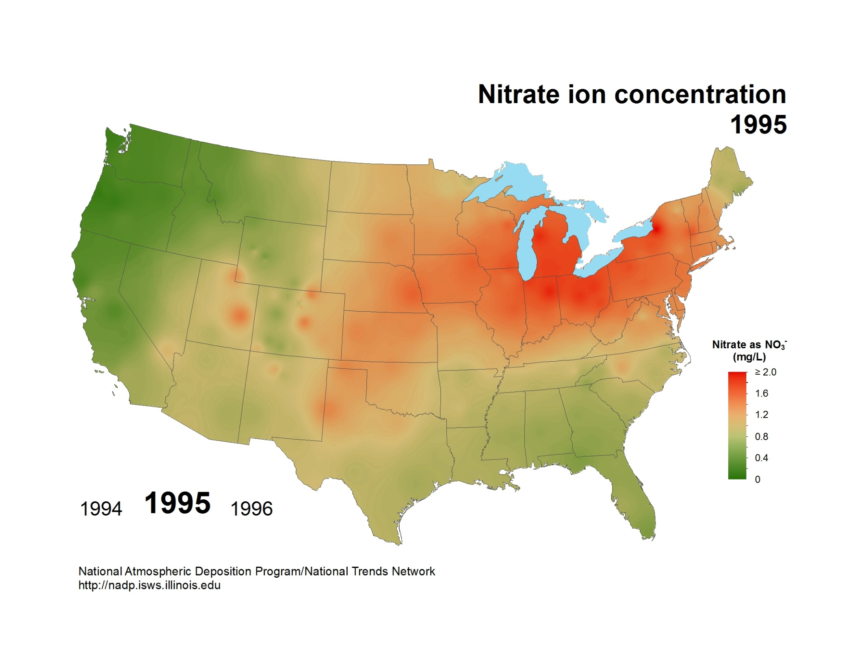
National Atmospheric Deposition Program/National Trends Network
http://nadp.slh.wisc.edu

Slide 12

National Atmospheric Deposition Program/National Trends Network
http://nadp.slh.wisc.edu

Slide 13
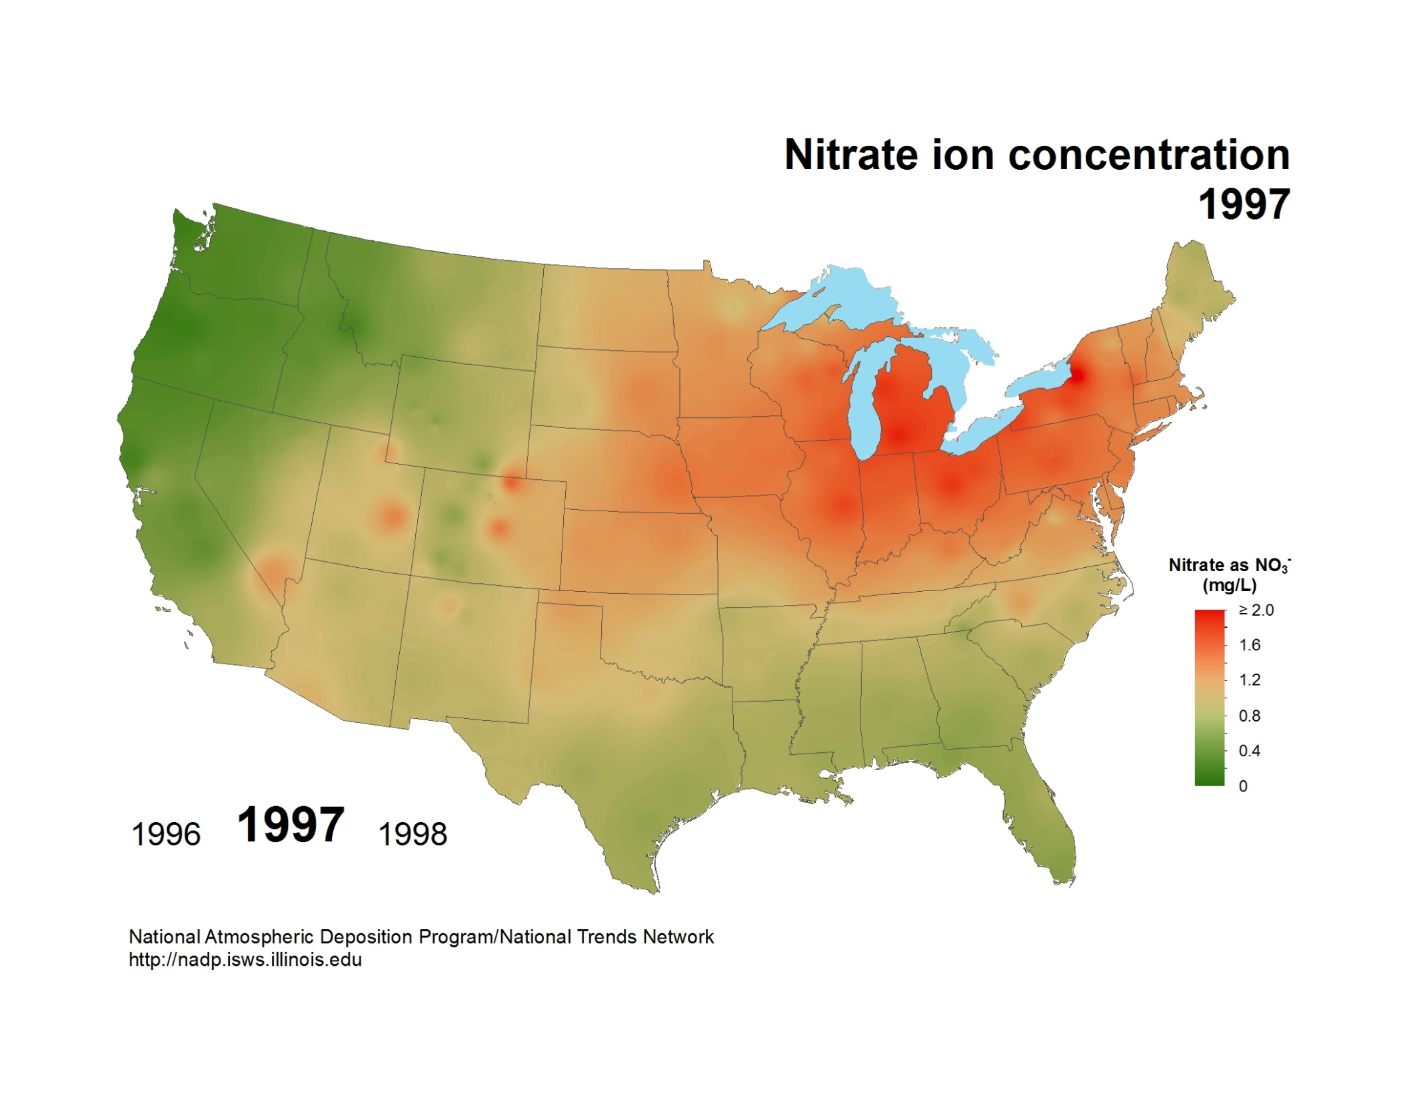
National Atmospheric Deposition Program/National Trends Network
http://nadp.slh.wisc.edu

Slide 14

National Atmospheric Deposition Program/National Trends Network
http://nadp.slh.wisc.edu

Slide 15
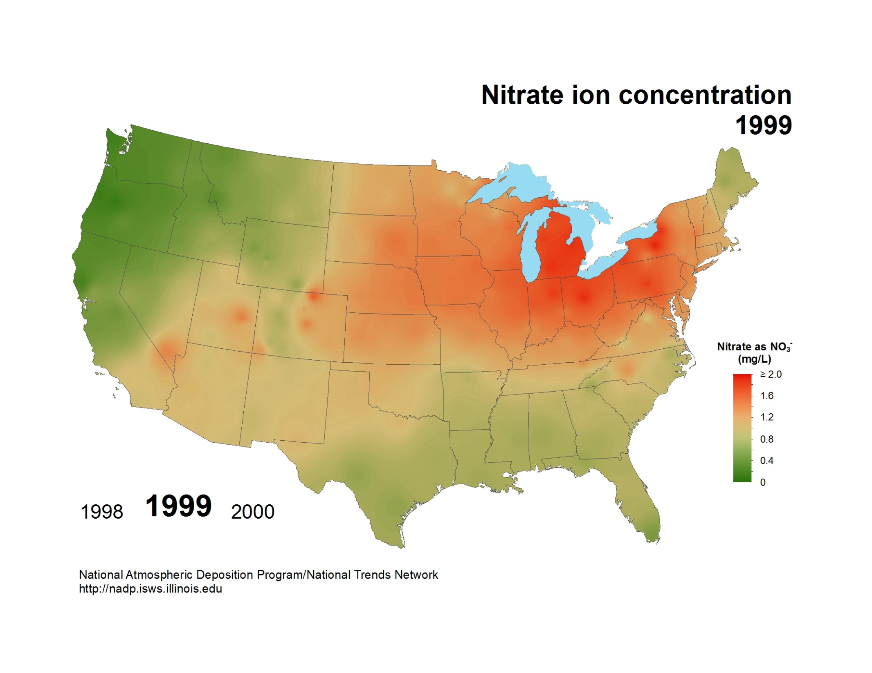
National Atmospheric Deposition Program/National Trends Network
http://nadp.slh.wisc.edu

Slide 16
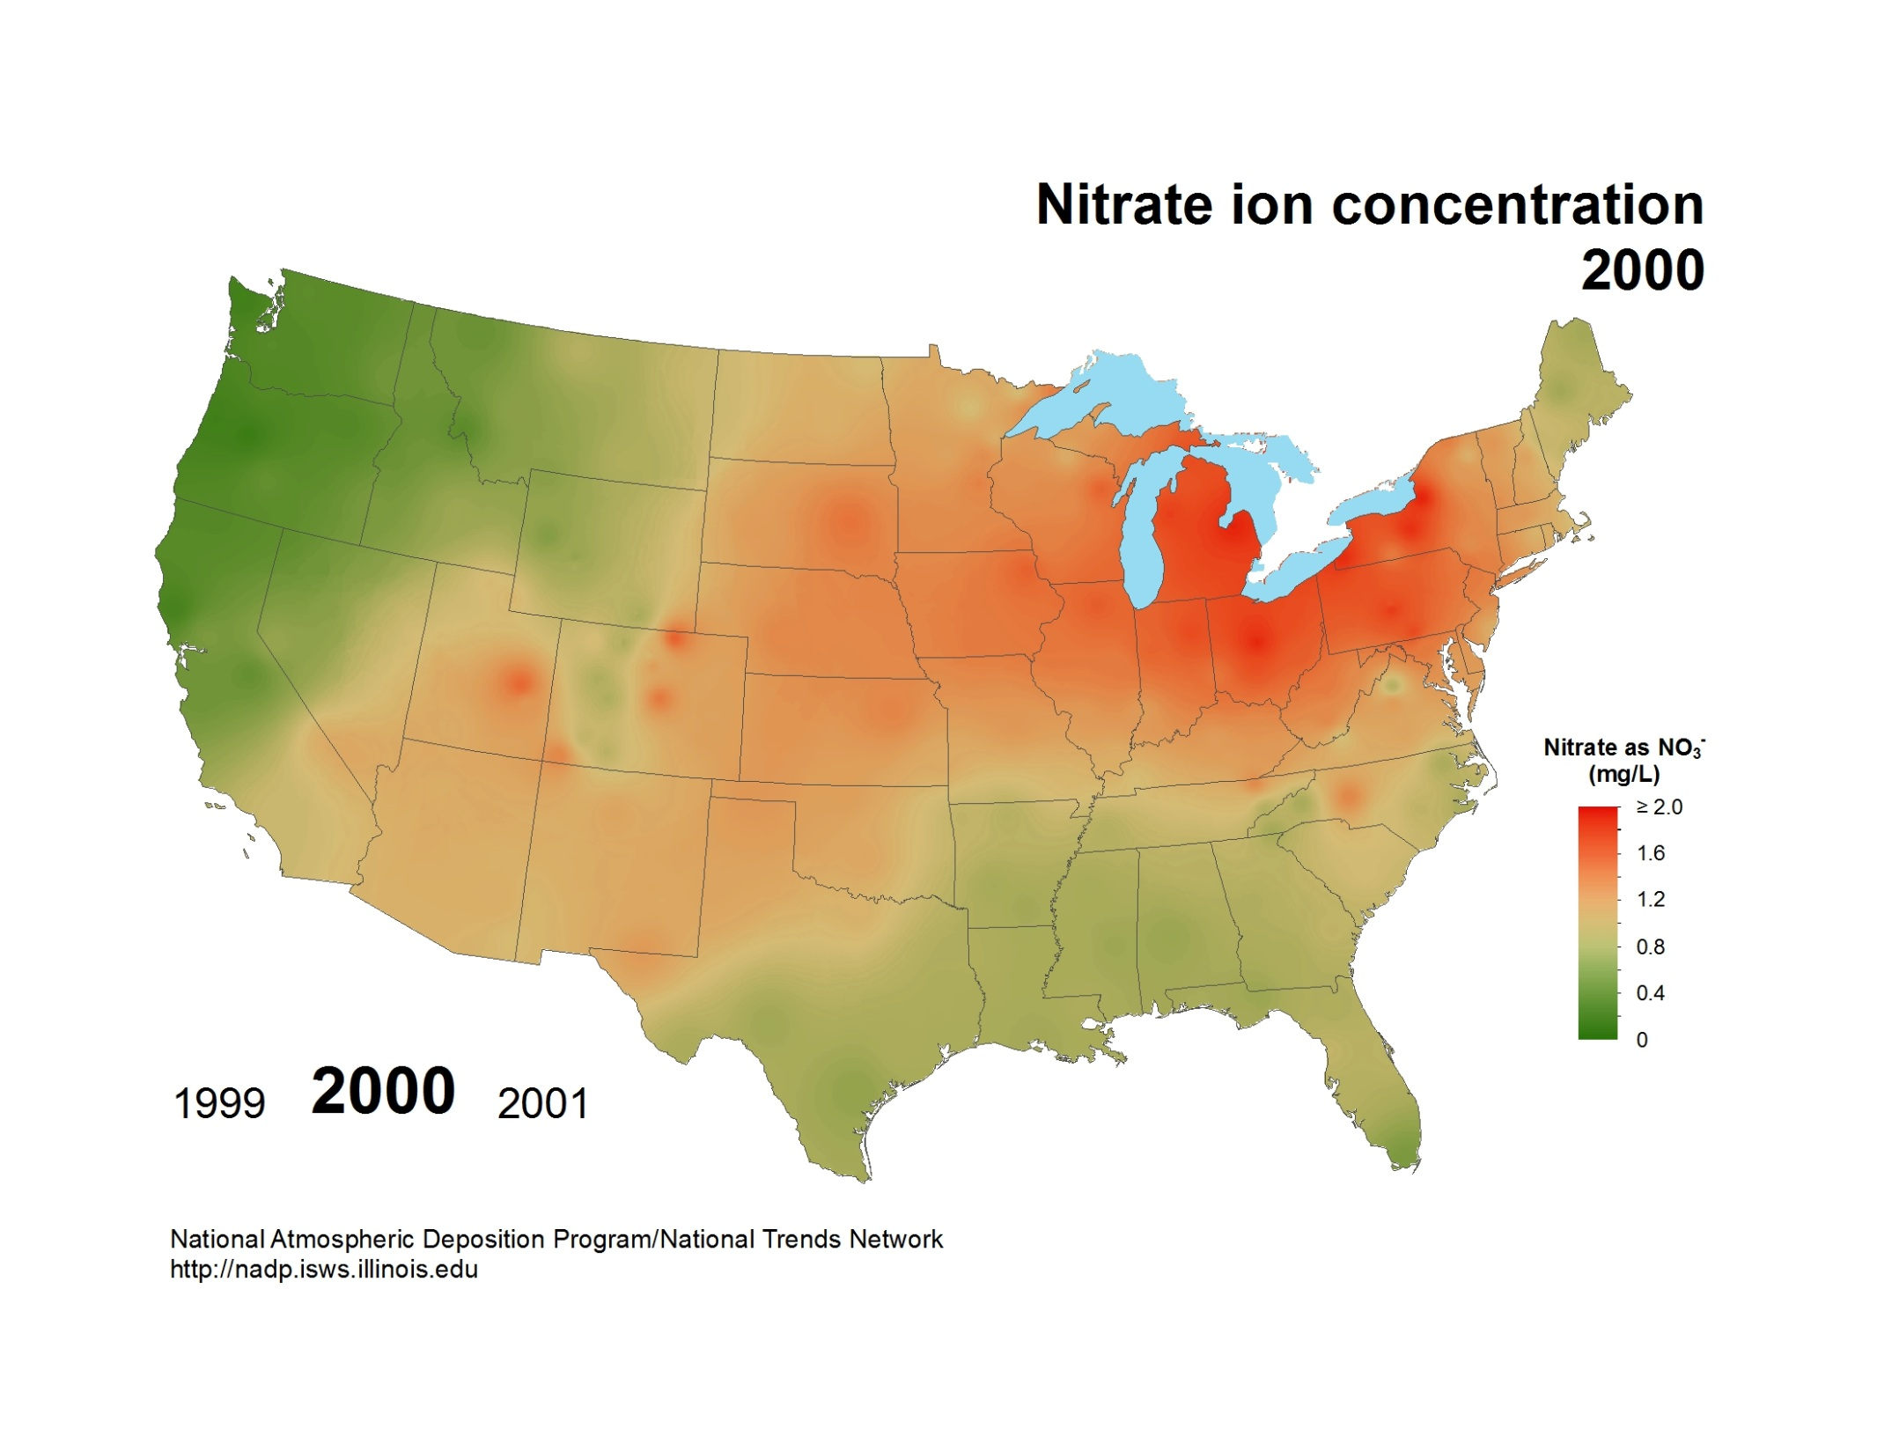
National Atmospheric Deposition Program/National Trends Network
http://nadp.slh.wisc.edu

Slide 17
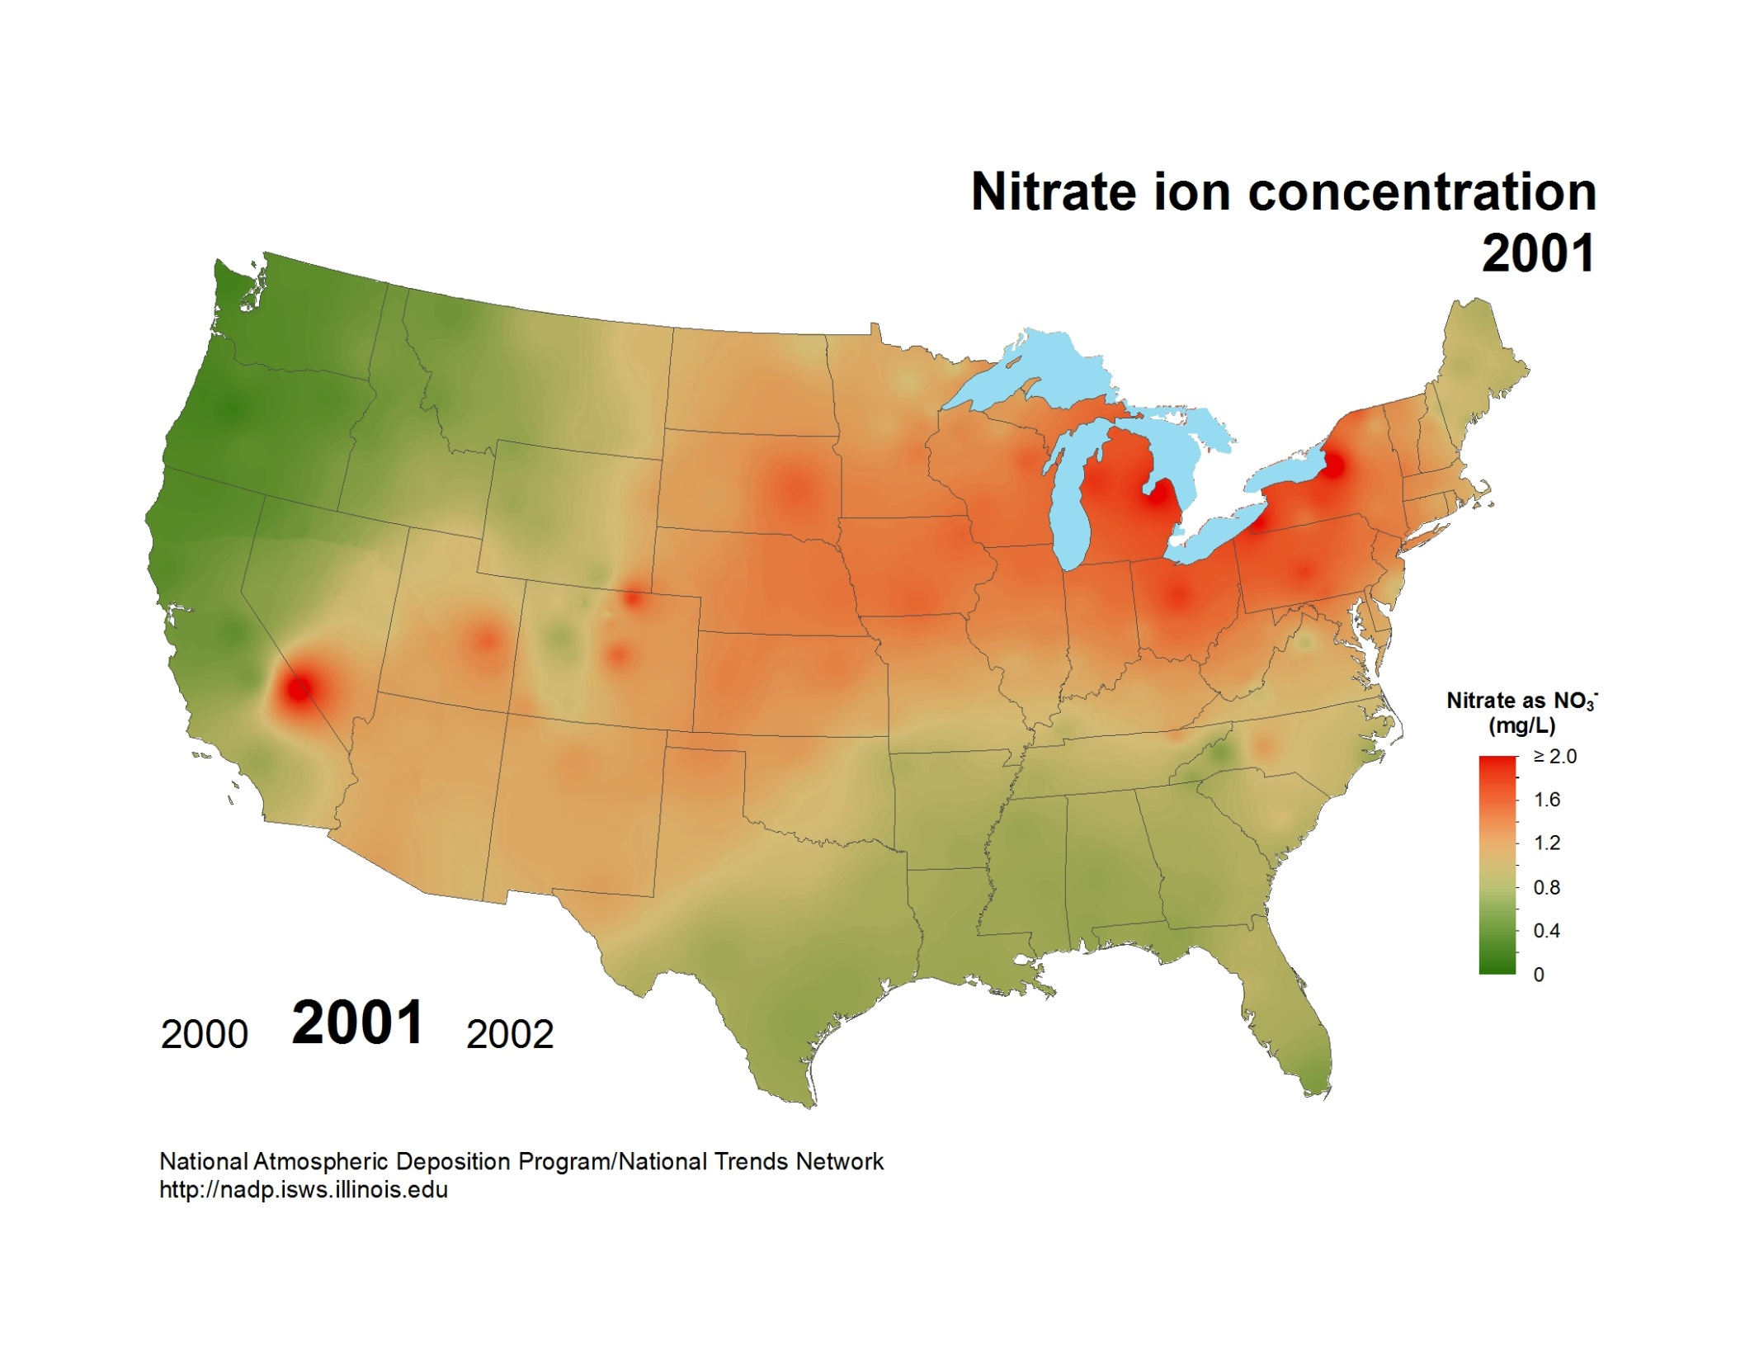
National Atmospheric Deposition Program/National Trends Network
http://nadp.slh.wisc.edu

Slide 18
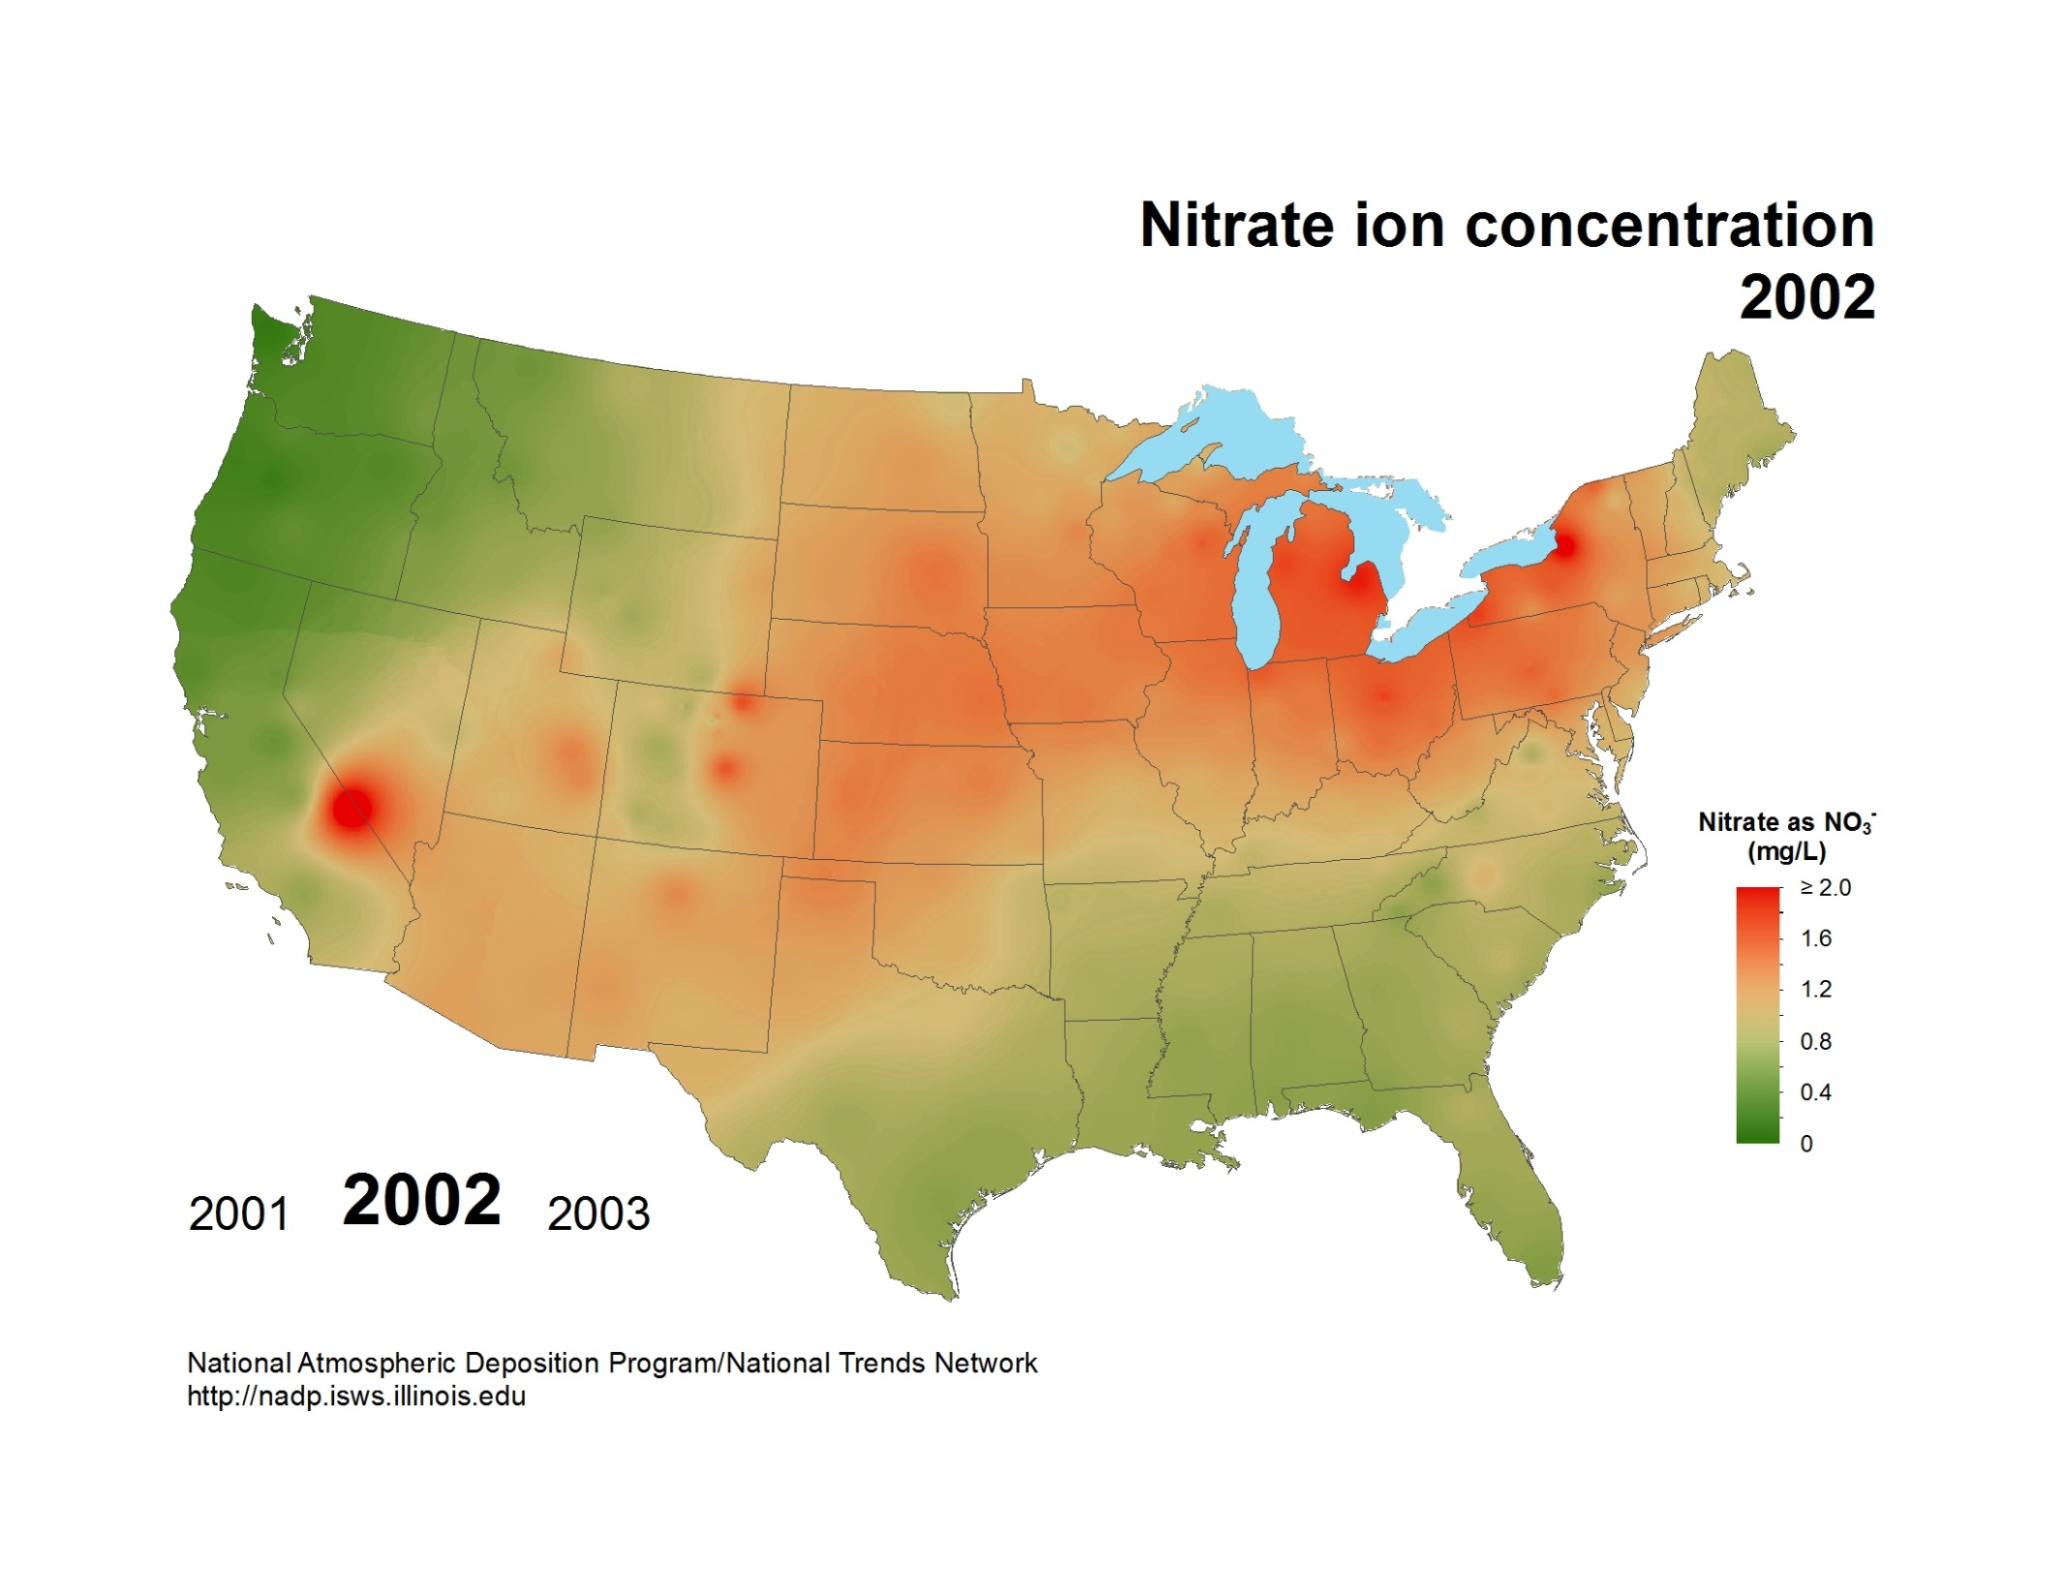
National Atmospheric Deposition Program/National Trends Network
http://nadp.slh.wisc.edu

Slide 19

National Atmospheric Deposition Program/National Trends Network
http://nadp.slh.wisc.edu

Slide 20
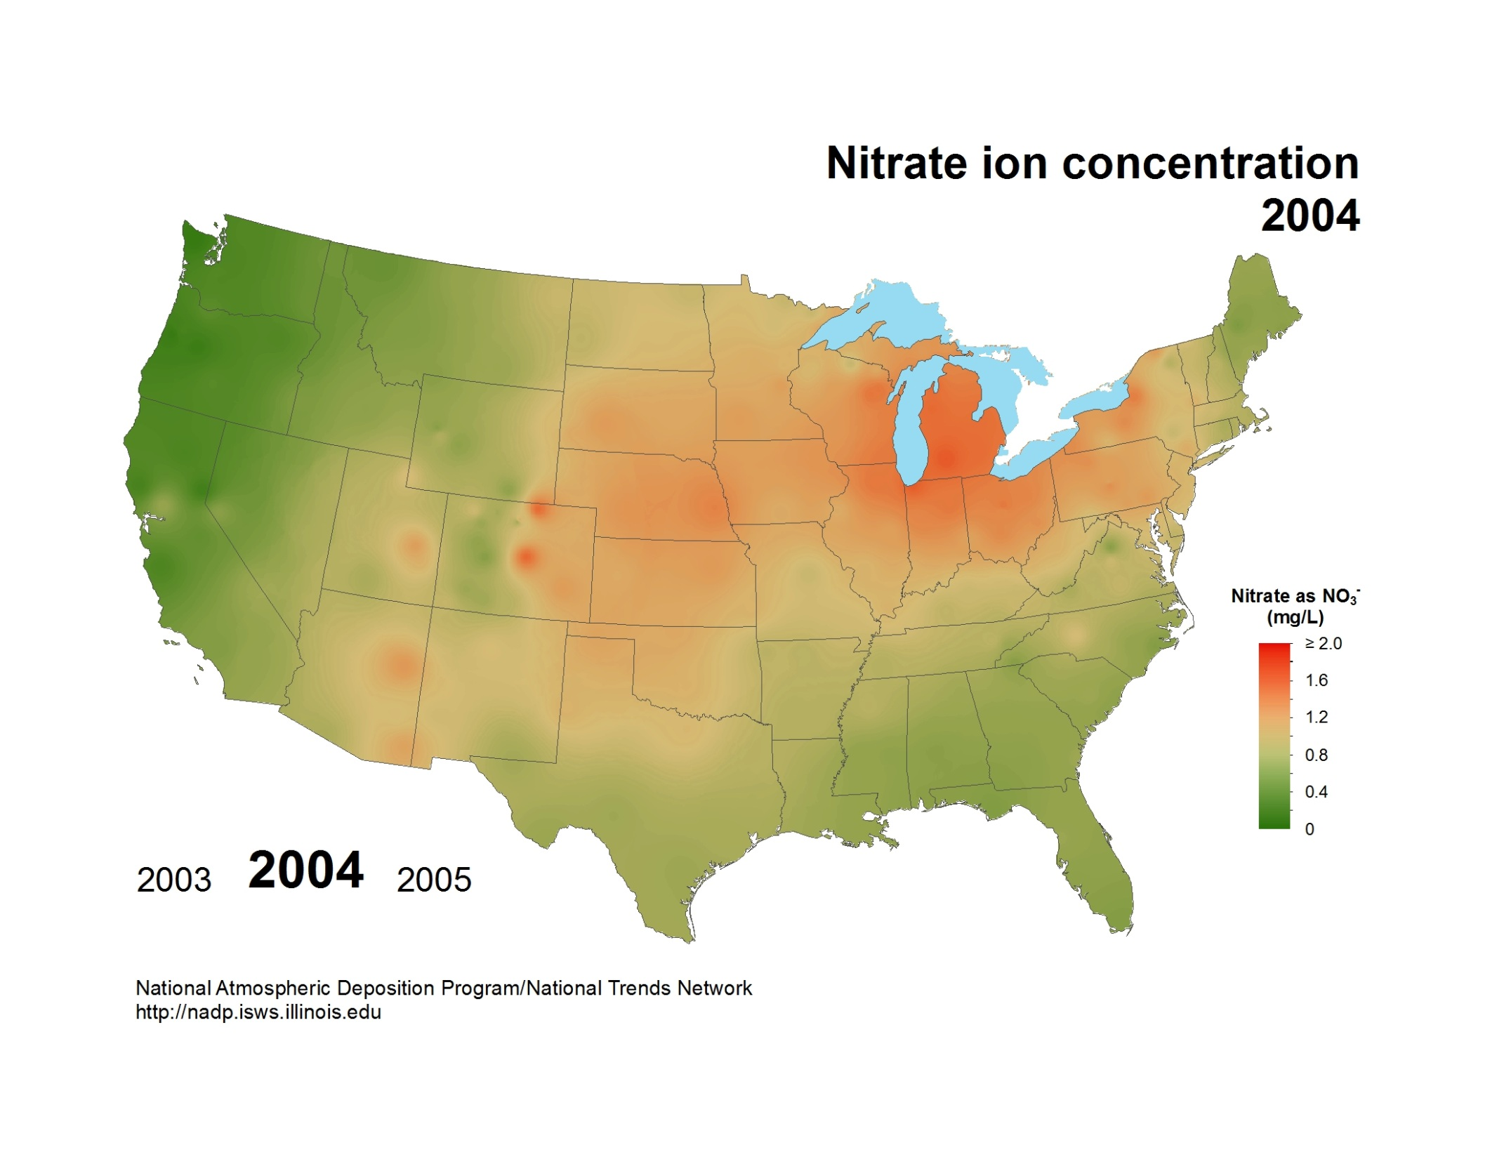
National Atmospheric Deposition Program/National Trends Network
http://nadp.slh.wisc.edu

Slide 21

National Atmospheric Deposition Program/National Trends Network
http://nadp.slh.wisc.edu

Slide 22
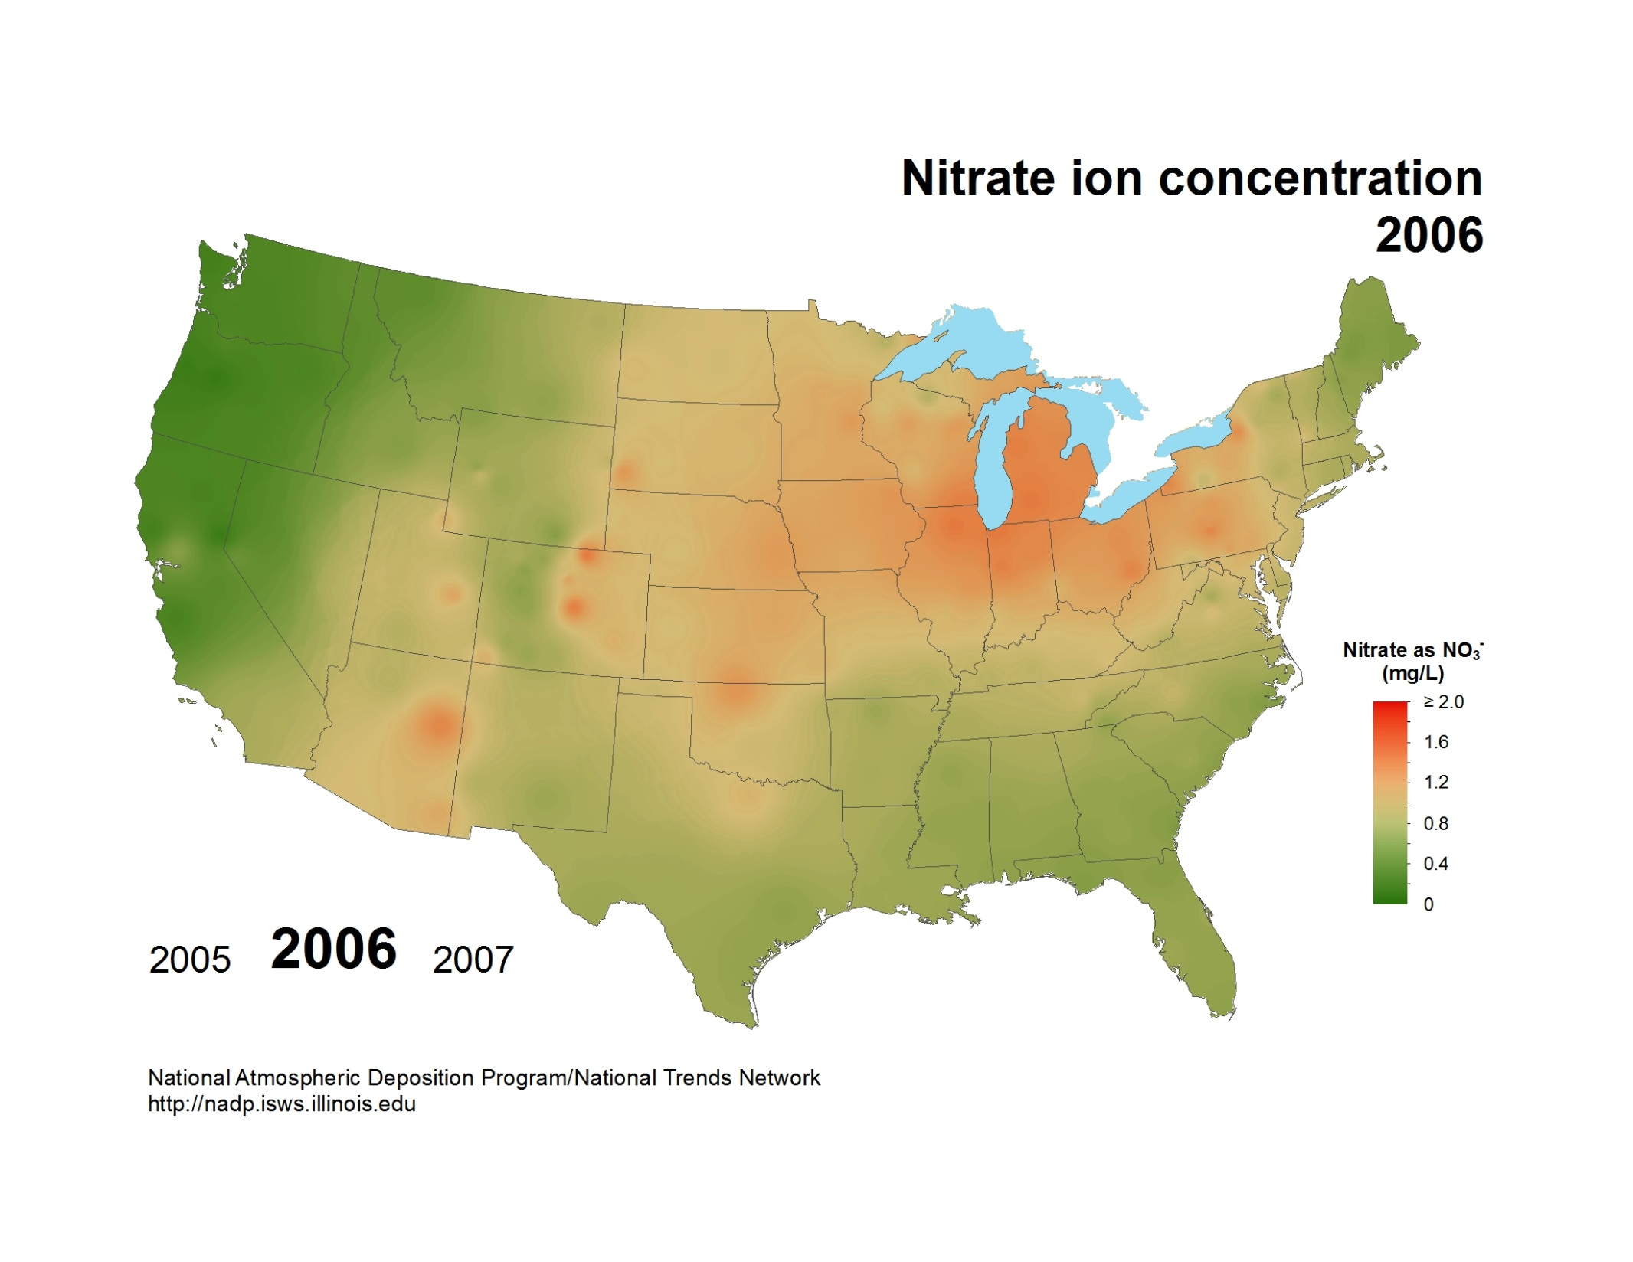
National Atmospheric Deposition Program/National Trends Network
http://nadp.slh.wisc.edu

Slide 23
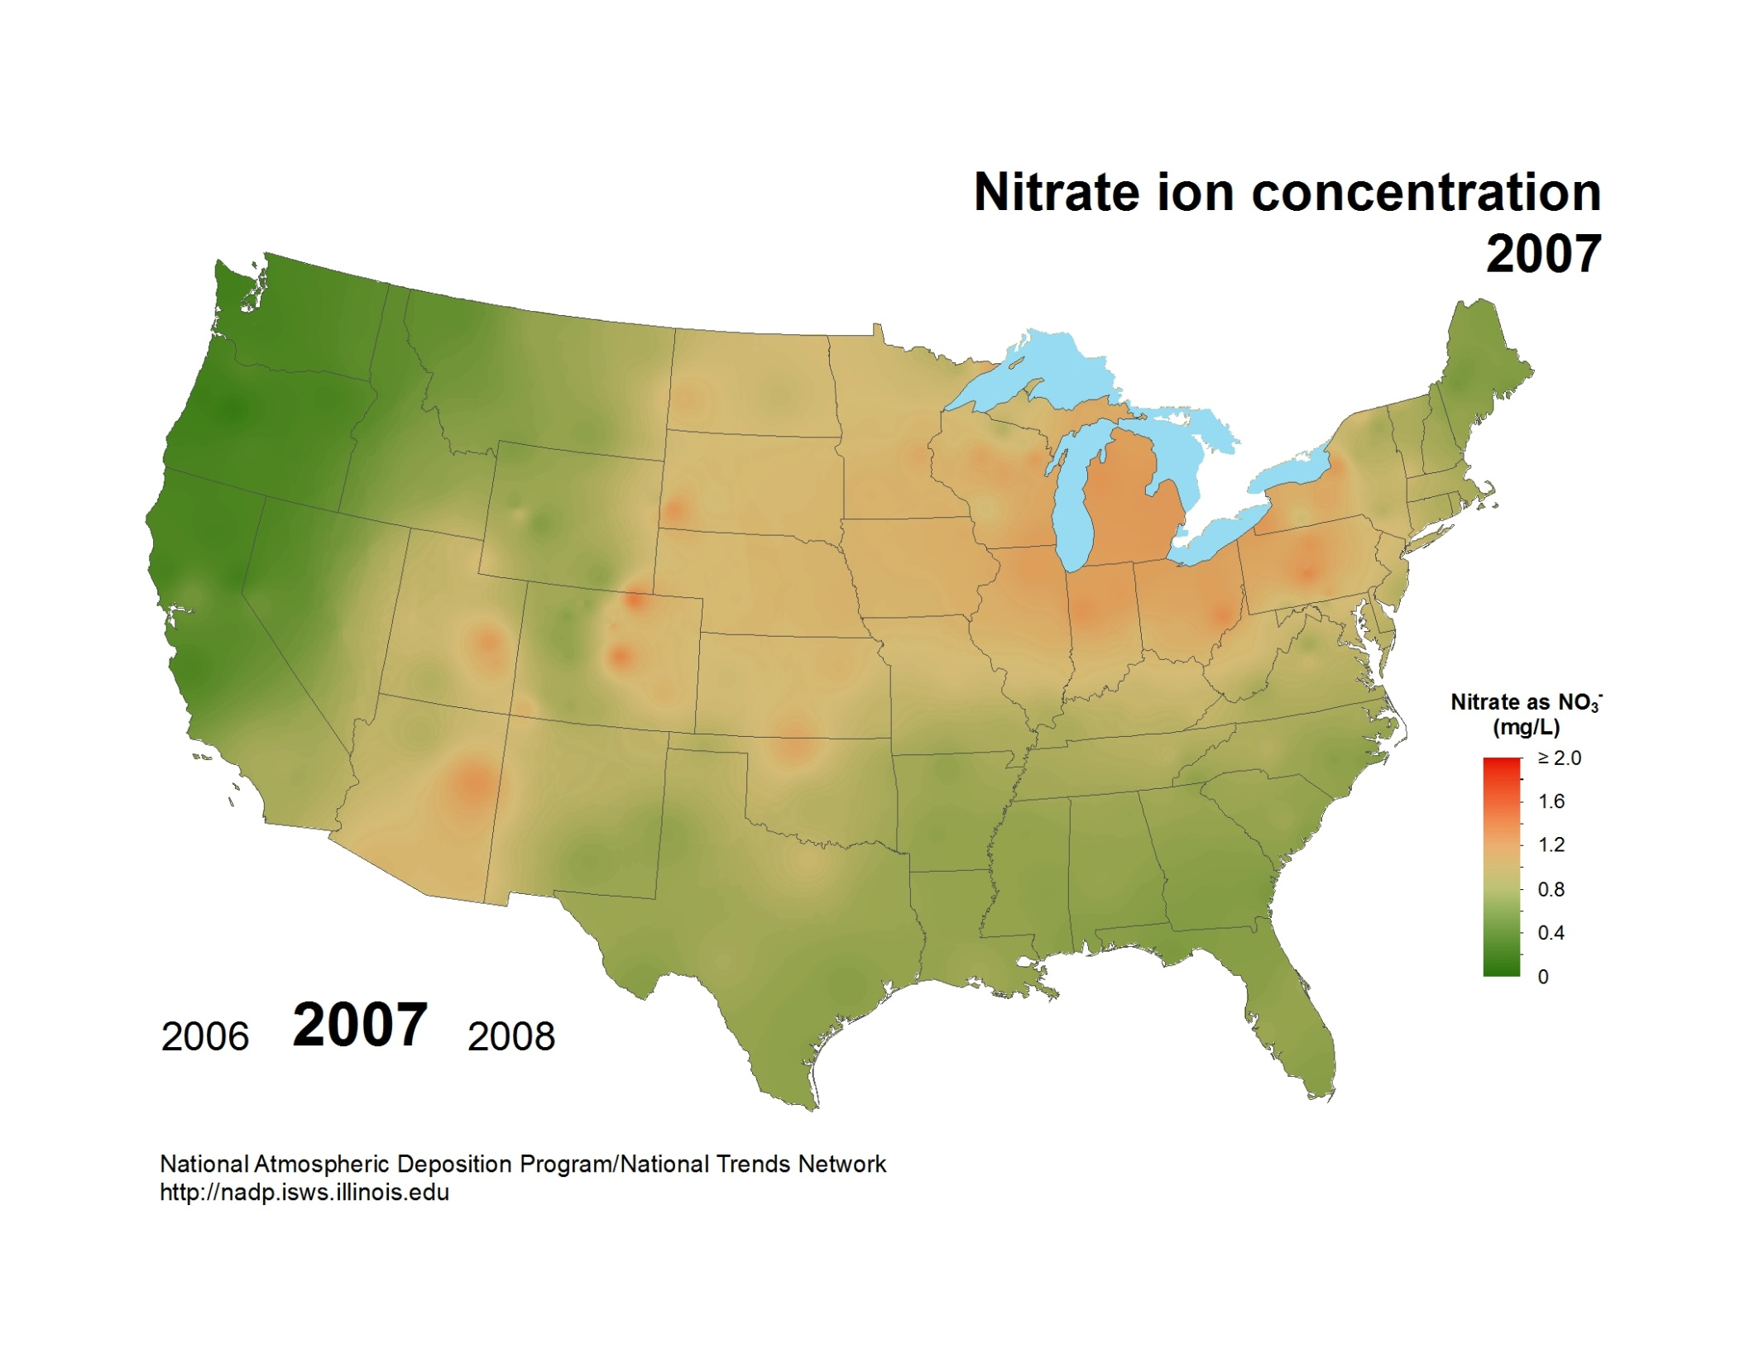
National Atmospheric Deposition Program/National Trends Network
http://nadp.slh.wisc.edu

Slide 24
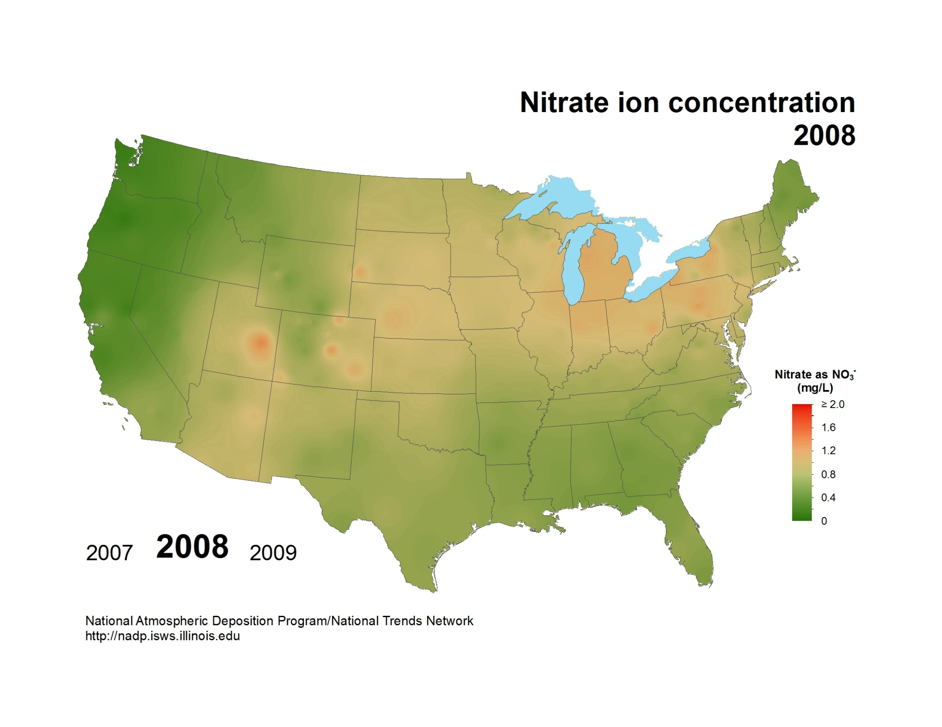
National Atmospheric Deposition Program/National Trends Network
http://nadp.slh.wisc.edu

Slide 25
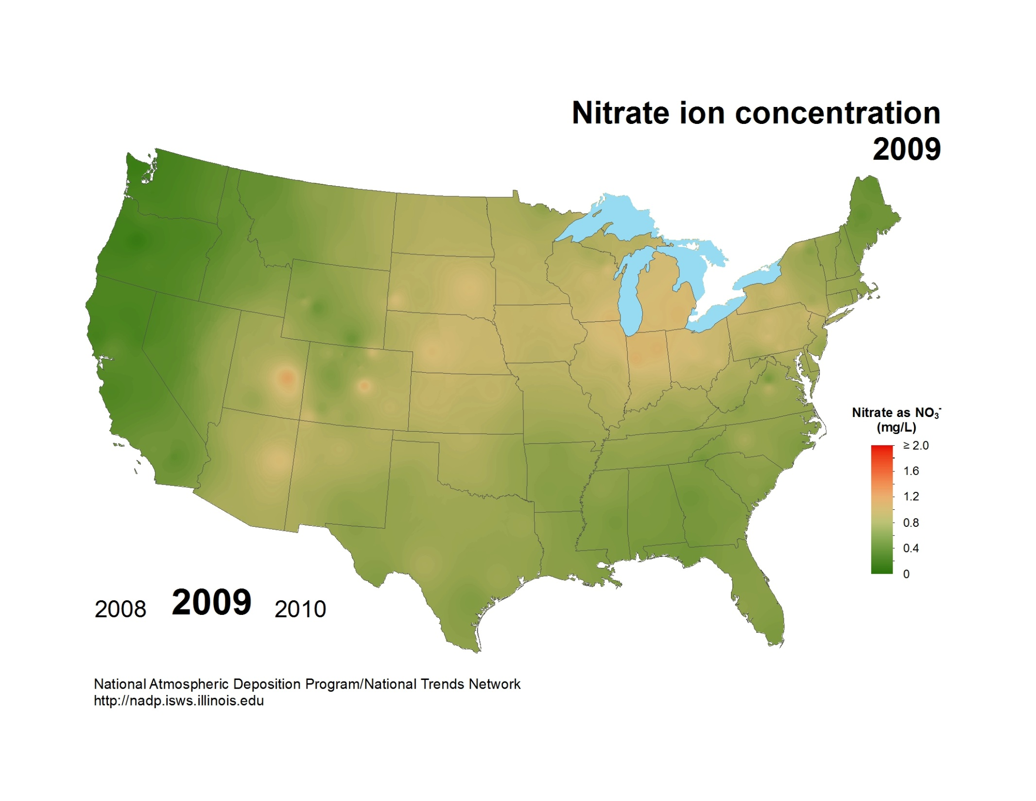
National Atmospheric Deposition Program/National Trends Network
http://nadp.slh.wisc.edu

Slide 26
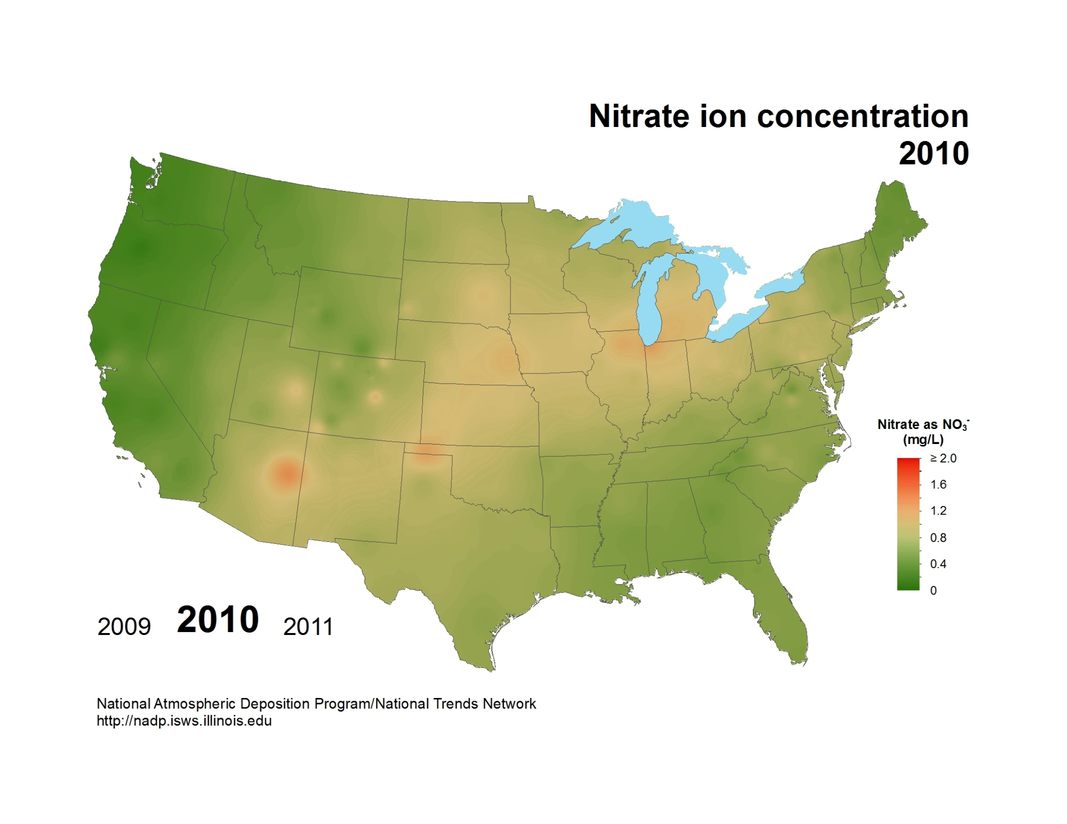
National Atmospheric Deposition Program/National Trends Network
http://nadp.slh.wisc.edu

Slide 27
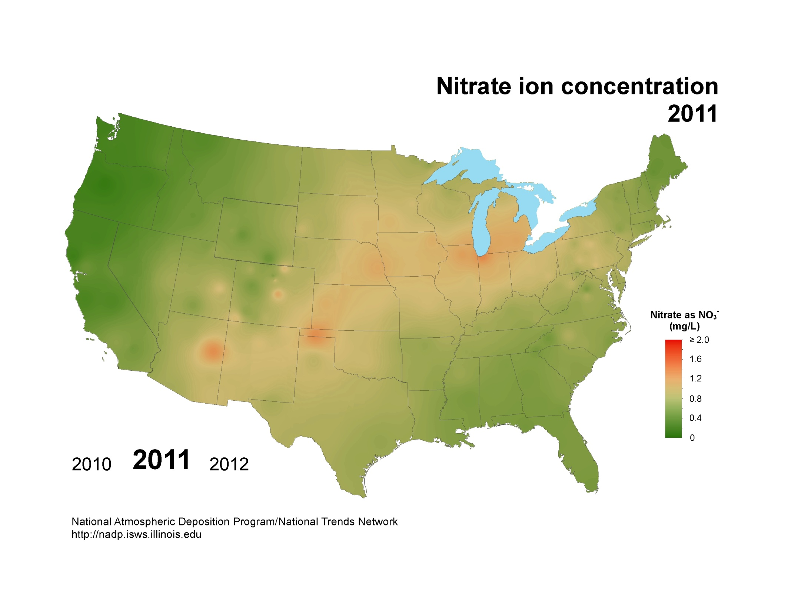
National Atmospheric Deposition Program/National Trends Network
http://nadp.slh.wisc.edu

Slide 28
National Atmospheric Deposition Program/National Trends Network
http://nadp.slh.wisc.edu

Slide 29
National Atmospheric Deposition Program/National Trends Network
http://nadp.slh.wisc.edu

Slide 30
National Atmospheric Deposition Program/National Trends Network
http://nadp.slh.wisc.edu

Slide 31
National Atmospheric Deposition Program/National Trends Network
http://nadp.slh.wisc.edu

Slide 32
National Atmospheric Deposition Program/National Trends Network
http://nadp.slh.wisc.edu

Slide 33
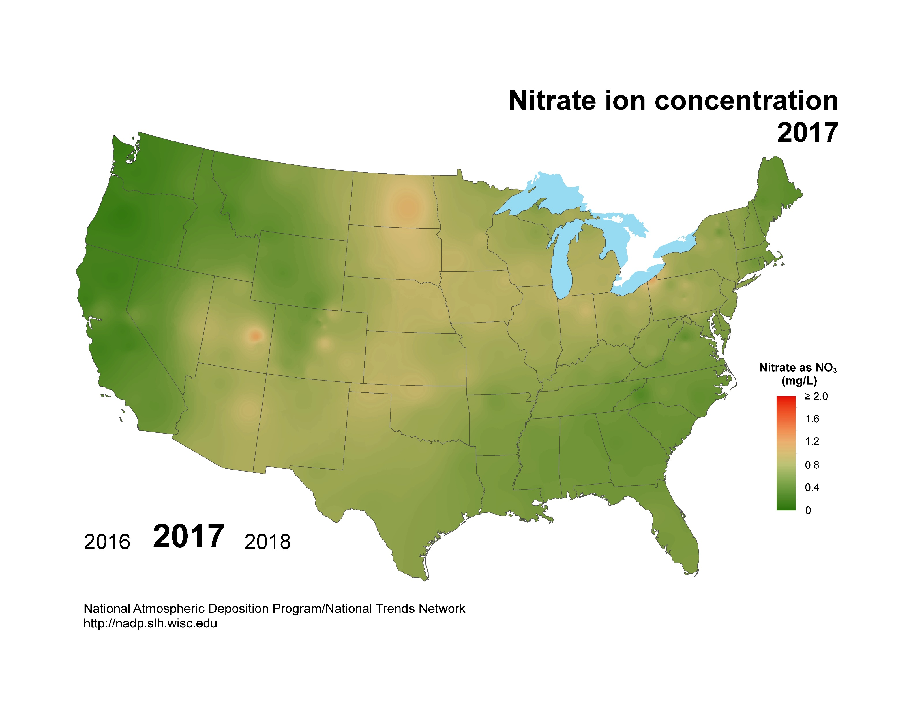
National Atmospheric Deposition Program/National Trends Network
http://nadp.slh.wisc.edu

Slide 34

National Atmospheric Deposition Program/National Trends Network
http://nadp.slh.wisc.edu

Slide 35

National Atmospheric Deposition Program/National Trends Network
http://nadp.slh.wisc.edu

