Slide 1
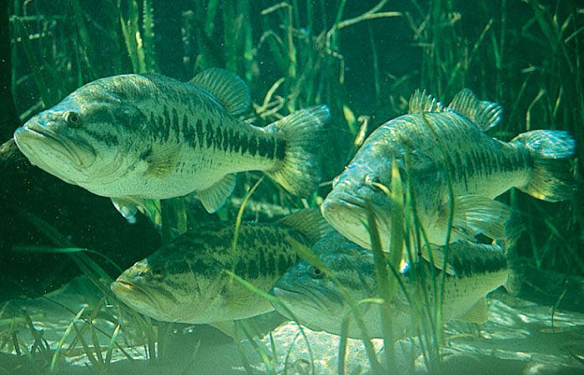

Contaminated Fish:
The Mercury Connection

Slide 2
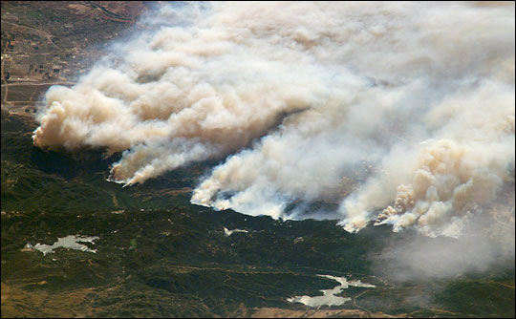
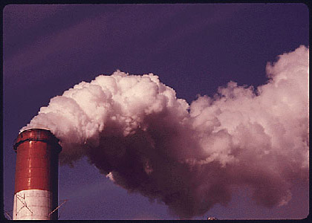

Mercury Sources
Natural Sources:
Occurs naturally in soils, sediments, and rocks
Volcanic eruptions
Wildfires
Man-Made Sources:
Coal combustion
Medical waste incineration
Chemical manufacturing

Slide 3
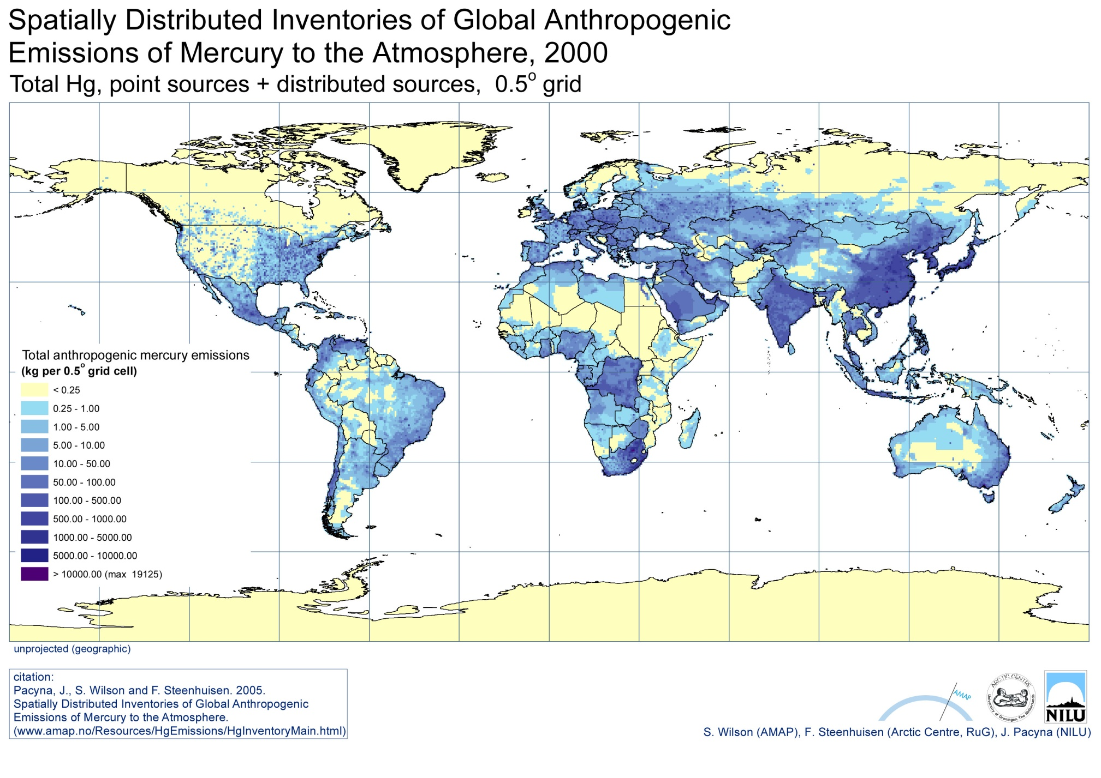
Major Sources of Mercury Emission

Slide 4
Mercury Transport
Rain and snow wash mercury out of the environment and into oceans, lakes, and rivers
Natural processes in water convert mercury to its toxic form, methyl mercury
Fish species consume methyl mercury
Methyl mercury levels accumulate in large fish and humans (bioaccumulation)

Slide 5
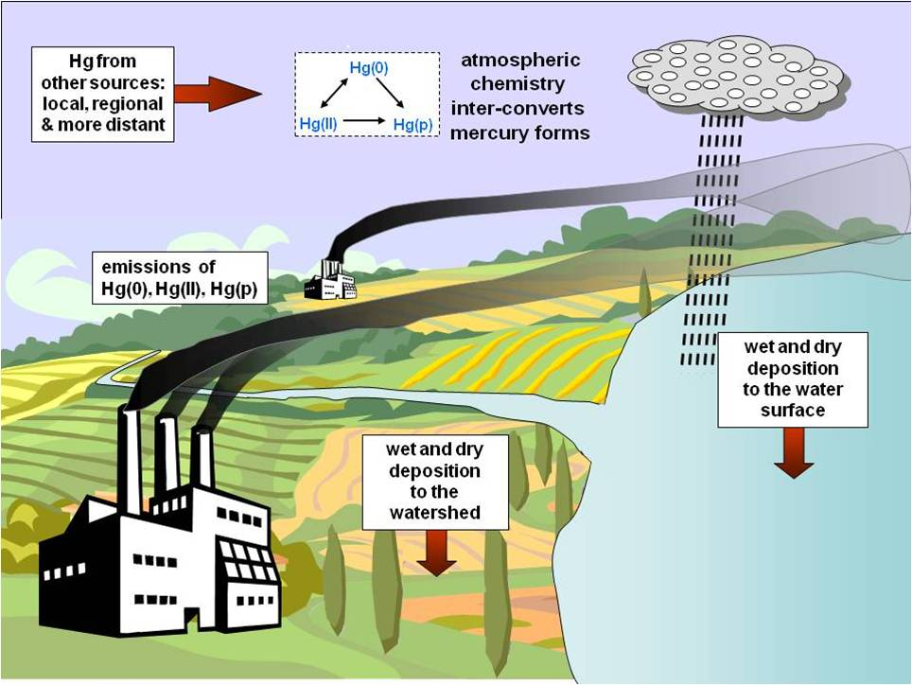
Mercury Transport

Slide 6
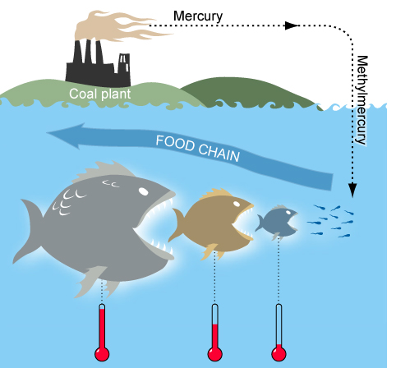
Up the Food Chain

Slide 7
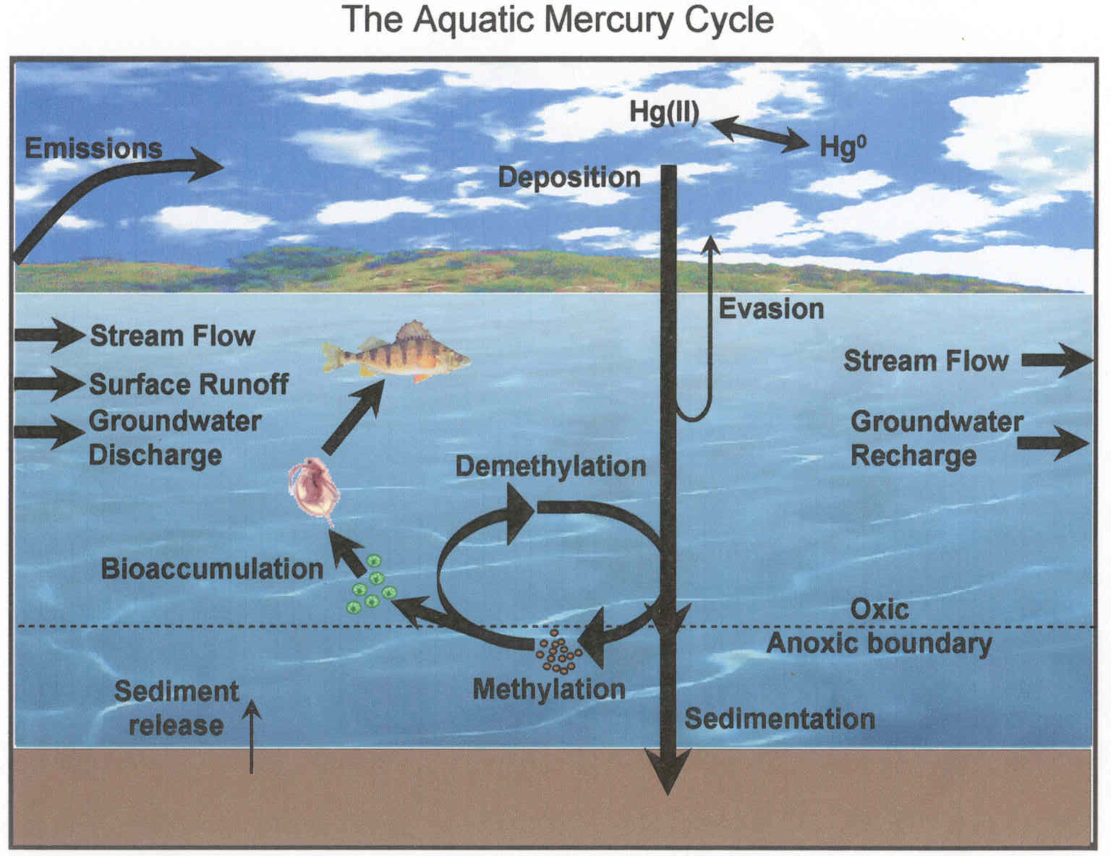
The Aquatic Mercury Cycle
Food Chain
Notes:
Inorganic mercury that is deposited from the atmosphere is converted to methyl mercury by the activity of bacteria in anoxic soil and water. This methyl mercury is the form of mercury that accumulates in the food web and contaminates fish, posing a threat to people and wildlife that consume fish.
Microbes from diverse taxonomic groups have demonstrated to capacity to methylate Hg in laboratory studies, most often associated with sulfate reducing bacteria belonging to the deltaproteobacteria division
Controls on mercury methylation in natural environments are not well understood
Availability of Hg, DOC, and electron acceptors such as SO₄²⁻ are correlated with meHg production
When transported to anoxic hypolimnia or sediments, Hg²⁺ compounds can be transformed into methylmercury.

Slide 8

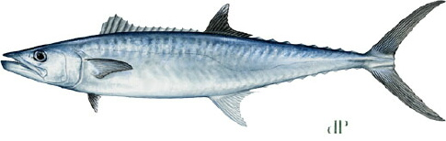
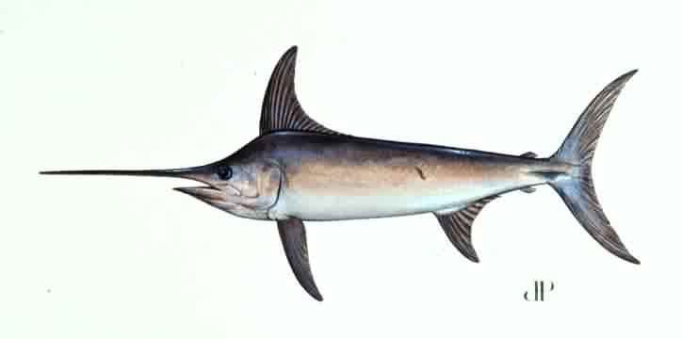
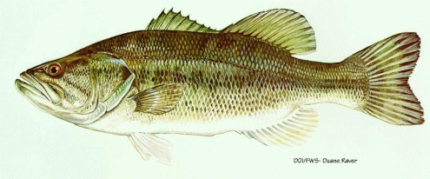
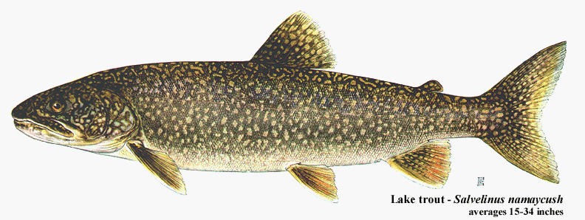
Top of the Aquatic Food Chain
Large, long-living predator fish
King mackerel
Shark
Walleye
Northern pike
Largemouth bass
Swordfish
Lake trout
Notes:
Methyl mercury concentrations in large fish can be more than a million times higher than the initial concentration. When consumed by adults, methyl mercury takes about 70 days for half of the mercury ingested to be removed from the body. When we consume mercury faster than our bodies can remove it, concentrations increase.

Slide 9

At-Risk Populations
Children are most susceptible to Mercury;
Pregnant women
Women who might become pregnant
Nursing mothers
Young children
Notes:
For most people, mercury in fish does not pose a health concern. People in special populations should understand their risk and follow government advisories on fish consumption.

Slide 10

Human Health Effects of Mercury
Damage to:
Heart
Kidneys
Central Nervous System
(neurotoxin)
Notes:
Methyl mercury easily reaches the bloodstream and is distributed to all tissues; it can also cross the normally protective blood-brain barrier and enter the brain. It will also readily move through the placenta to developing fetuses. Low-level exposure is linked to learning disabilities in children. What’s more, methyl mercury is listed by the U.S. Environmental Protection Agency as a possible human carcinogen.

Slide 11
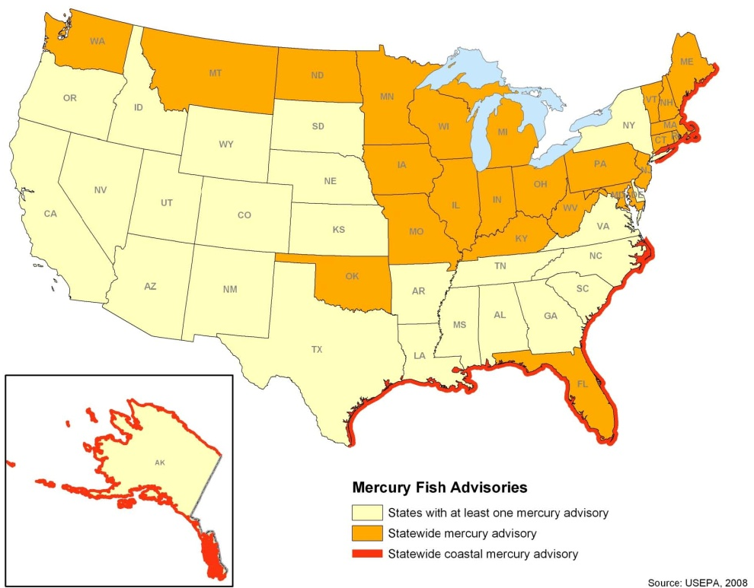
Advisories & Guidelines
Issued advisories for populations at risk to limit fish intake and avoid various larger species.
USEPA guidelines for safe fish consumption: levels of under 0.3 parts per million.

Slide 12

Research
Studies show nearly all fish contain traces of methyl mercury.
Methyl mercury concentrations are highest in fish living in:
Heavily polluted areas
Coastal wetlands of Florida Everglades, Gulf of Mexico, the Atlantic Ocean, San Francisco Bay

Slide 13
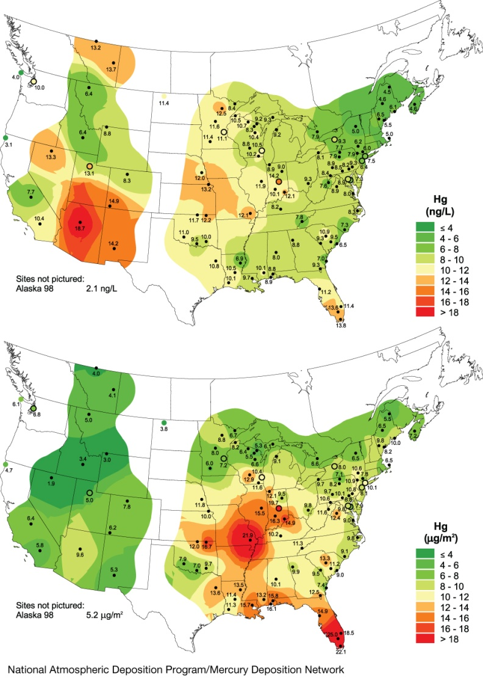
NADP Mercury Deposition Network
MDN samples mercury in rain and snow to help researchers determine trends on mercury deposition: where it is deposited, at which rate, and at which concentration.
Total annual average mercury concentation in rainfall (top), and total annual mercury wet deposition (bottom) in 2008.

Slide 14
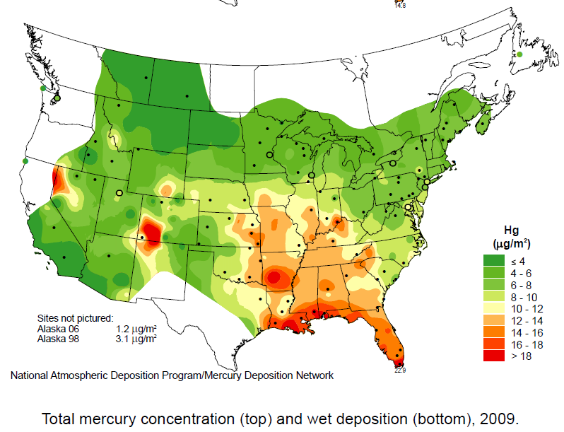
2009 Mercury Deposition

Slide 15
For more information about this presentation or the NADP, please contact:
NADP Program Office
Wisconsin State Laboratory of Hygiene
E-mail: nadp@slh.wisc.edu
NADP Web site: http://nadp.slh.wisc.edu
The NADP is National Research Support Project-3: A Long-Term Monitoring Program in Support of Research on the Effects of Atmospheric Chemical Deposition. More than 250 sponsors support the NADP, including private companies and other nongovernmental organizations, universities, local and state government agencies, State Agricultural Experiment Stations, national laboratories, Native American organizations, Canadian government agencies, the National Oceanic and Atmospheric Administration, the Environmental Protection Agency, the Tennessee Valley Authority, the U.S. Geological Survey, the National Park Service, the U.S. Fish & Wildlife Service, the Bureau of Land Management, the U.S. Department of Agriculture - Forest Service, and the U.S. Department of Agriculture - National Institute of Food and Agriculture, under agreement no. 2008-39134-19508. Any opinions, findings, and conclusions or recommendations expressed in this publication are those of the author(s) and do not necessarily reflect the views of the sponsors or the Wisconsin state :Laboratory of Hygiene.

Slide 16
Title: “Contaminated Fish: The Mercury Connection”
Audience: High school students, high school science teachers
Plan: offer it on the web as a presentation download (for Teachers to use) or as a pdf download
Notes:

