Slide 1
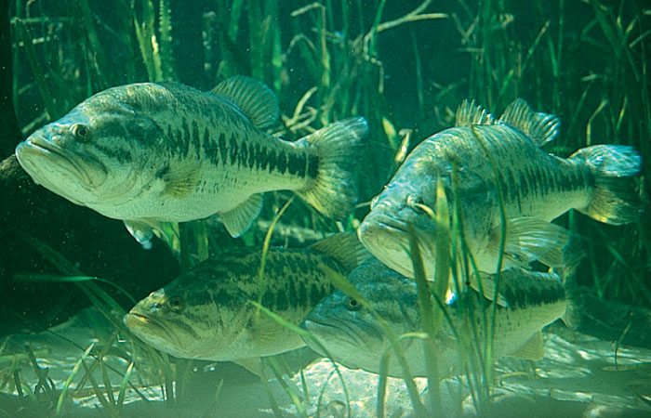
Mercury in Fish

Slide 2
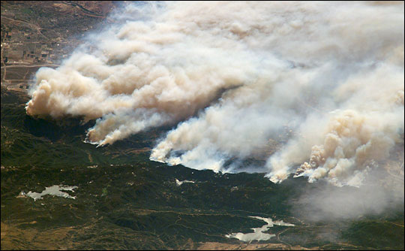
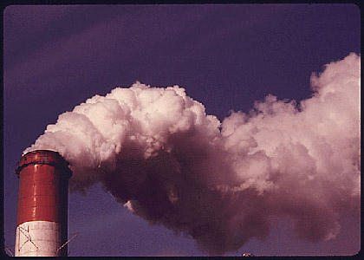
Where Does Mercury Come From?
Natural Sources:
Soils and rocks
Wildfires
Man-Made Sources:
Burning coal and medical waste
Manufacturing chemicals

Slide 3
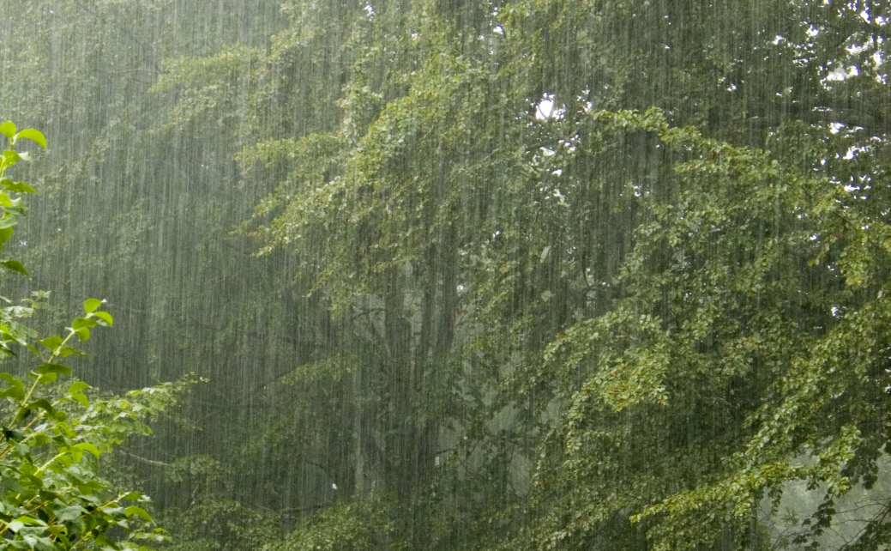
What Happens to Mercury?
Rain and snow wash mercury out of the environment and into oceans, lakes, and rivers
In water, mercury becomes its toxic form, methyl mercury
Fish species eat methyl mercury when they eat other fish

Slide 4
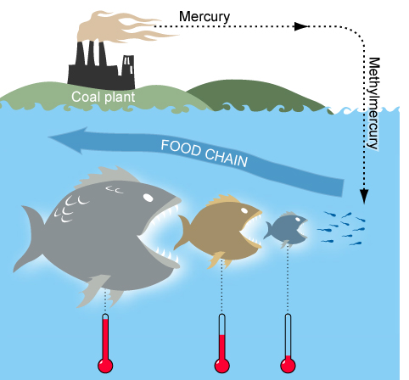
Up the Food Chain

Slide 5
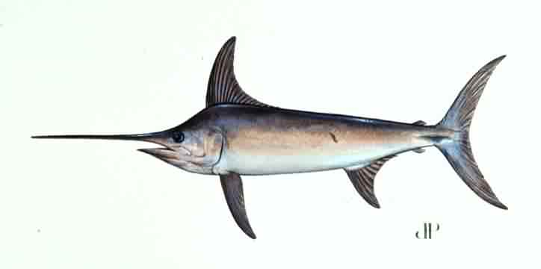
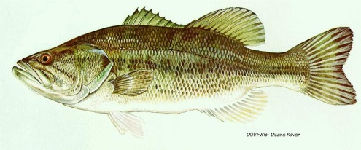
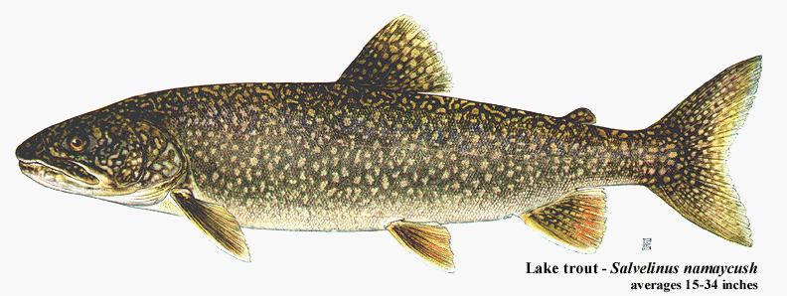
Top of the Aquatic Food Chain
Large, long-living predator fish
King mackerel
Shark
Walleye
Northern pike
Largemouth bass
Swordfish
Lake trout

Slide 6
Human Health Effects of Mercury
Damage to:
Heart
Kidneys
Central Nervous System

Slide 7
Research
Nearly all fish contain some amount of methyl mercury.
Young children should follow government rules on eating fish.
Notes:
http://www.epa.gov/mercury/advisories.htm

Slide 8
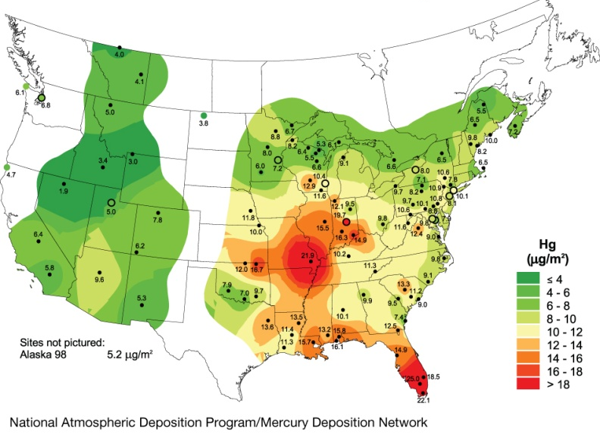
NADP Mercury Deposition Network
MDN samples mercury
in rain and snow to help researchers determine trends on mercury deposition: where it is deposited, at which rate, and at what concentration.
Total annual average mercury concentration in rainfall (top), and total annual mercury wet deposition (bottom) in 2008.

Slide 9
For more information about this presentation or the NADP, please contact:
NADP Program Office
Wisconsin State Laboratory of Hygiene
E-mail: nadp@slh.wisc.edu
NADP Web site: http://nadp.slh.wisc.edu
The NADP is National Research Support Project-3: A Long-Term Monitoring Program in Support of Research on the Effects of Atmospheric Chemical Deposition. More than 250 sponsors support the NADP, including private companies and other nongovernmental organizations, universities, local and state government agencies, State Agricultural Experiment Stations, national laboratories, Native American organizations, Canadian government agencies, the National Oceanic and Atmospheric Administration, the Environmental Protection Agency, the Tennessee Valley Authority, the U.S. Geological Survey, the National Park Service, the U.S. Fish & Wildlife Service, the Bureau of Land Management, the U.S. Department of Agriculture - Forest Service, and the U.S. Department of Agriculture - National Institute of Food and Agriculture, under agreement no. 2008-39134-19508. Any opinions, findings, and conclusions or recommendations expressed in this publication are those of the author(s) and do not necessarily reflect the views of the sponsors or the Wisconsin state :Laboratory of Hygiene.

